Slide 1
Medical Assistance in Dying (MAID): An update April 7, 2023
Lilian Thorpe BSc Hon (U of Regina), MD and MSc (U of Toronto), PhD (Epidemiology), FRCP (Psychiatry)
Professor, Departments of Psychiatry &
Community Health & Epidemiology
University of Saskatchewan
Saskatchewan Health authority

Slide 2
Faculty/Presenter Disclosure
Faculty: Lilian Thorpe
Relationships with financial sponsors:
Grants/Research Support: Nil
Speakers Bureau/Honoraria: Canadian Association of MAID Assessors and Providers (CAMAP) for involvement in developing training guidelines for assessors and providers
Consulting Fees: Health Canada
Patents: Nil
Other: Nil
Notes:
This slide must be visually presented to the audience AND verbalized by the speaker.

Slide 3
Biography
Actively involved in MAID related clinical work, teaching, research graduate supervision.
Member, Health Canada MAID Practice Standards Task Group, 2022-2023
Member, Canadian Association of MAID Assessors and Providers (CAMAP) team developing national curriculum on assessing capacity and vulnerability, 2021-2023
Member, CAMAP Guidelines Working Group on MAiD assessments for people with Chronic Complex Conditions 2021-
Member and co-author, Canadian Association of MAID Assessors and Providers (CAMAP) Capacity Guidelines Working Group, April 2020
Member, Saskatchewan Health Authority/Saskatchewan Cancer Agency Joint Ethics Committee, May 2, 2020 –
Member of the (former) Saskatoon Health Region committee which developed the regional MAID policy, 2015-2016

Slide 4
References:
Health Canada. Model Practice Standard for Medical Assistance in Dying (MAID).
https://www.canada.ca/en/health-canada/services/publications/health-system-services/model-practice-standard-medical-assistance-dying.html
Health Canada. Advice to the Profession: Medical Assistance in Dying (MAID)
https://www.canada.ca/en/health-canada/services/publications/health-system-services/advice-profession-medical-assistance-dying.html
MAID And mental disorders: the road ahead. Report of the Special Joint Committee Medical Assistance in Dying. René Arseneault & Honourable Yonah, Martin Joint Chairs.
https://www.parl.ca/DocumentViewer/en/44-1/AMAD/report-3/
Final Report of the Expert Panel on MAiD and mental illness. May 2022
https://www.canada.ca/en/health-canada/corporate/about-health-canada/public-engagement/external-advisory-bodies/expert-panel-maid-mental-illness/final-report-expert-panel-maid-mental-illness.html
Special Joint Committee Report Medical Assistance in Dying and Mental Disorder as the Sole Underlying Condition: An Interim Report June 2022
https://www.parl.ca/DocumentViewer/en/44-1/AMAD/report-1
Special Joint Committee Report Medical Assistance in Dying in Canada: Choices for Canadians. Feb 2023
https://www.parl.ca/Content/Committee/441/AMAD/Reports/RP12234766/amadrp02/amadrp02-e.pdf
CPSS Policy. Medical Assistance in Dying: Patient’s Death is Reasonably Foreseeable
https://www.cps.sk.ca/iMIS/Documents/Legislation/Policies/POLICY%20-%20MAiD%20-%20Patient%E2%80%99s%20Death%20is%20Reasonably%20Foreseeable.pdf
CPSS Policy. Medical Assistance in Dying: Patient's Death is Not Reasonably Foreseeable
https://www.cps.sk.ca/iMIS/Documents/Legislation/Policies/POLICY%20-%20MAiD-Patient%E2%80%99s%20Death%20is%20Not%20Reasonably%20Foreseeable.pdf
CPSS Policy. Informed Consent and Determining Capacity to Consent
https://www.cps.sk.ca/iMIS/Documents/Legislation/Policies/POLICY%20-%20Informed%20Consent%20and%20Determining%20Capacity%20to%20Consent.pdf

Slide 5
Overview/Abstract
As the population ages there has been increasing focus on the end of life, including discontinuation of interventions no longer bringing benefit, improving palliative care, and most recently allowing patients to access a medically assisted death.
This has brought with it major clinical, legal, and ethical challenges to health care providers
This presentation summarizes clinical and legal issues related to MAID including recent expansion to those without reasonably foreseeable natural death and potential future addition of MAID for sole mental disorders (recently deferred again).

Slide 6
Learning Objectives
To briefly review legal requirements related to MAID
Reasonably foreseeable natural death
Not reasonably foreseeable natural death
To review upcoming challenges including MAID for sole mental disorders and advanced requests
To review clinical issues related to MAID assessment and provision

Slide 7
“I'm not afraid of death; I just don't want to be there when it happens.” ― Woody Allen

Slide 8
Leading causes of death, Canada, by sex, 2019
Statistics Canada. Table 13-10-0394-01 Leading causes of death, total population, by age group

Slide 9
What is a good death?
A good death is:
Free from avoidable distress and suffering for patient, family and caregivers
In general according with patient and families wishes
Reasonably consistent with clinical, cultural and ethical standards.
World Health Organization, 1997

Slide 10
Notes:
Soc Sci Med. 2009 May;68(10):1752-8. Epub 2009 Apr 1.
The rapidly changing location of death in Canada, 1994-2004.
Wilson DM, Truman CD, Thomas R, Fainsinger R, Kovacs-Burns K, Froggatt K, Justice C.
Faculty of Nursing, Third Floor Clinical Sciences Building, University of Alberta, Edmonton, Alberta, Canada T6T 1E8. donna.wilson@ualberta.ca
This 2008 study assessed location-of-death changes in Canada during 1994-2004, after previous research had identified a continuing increase to 1994 in hospital deaths. The most recent (1994-2004) complete population and individual-level Statistics Canada mortality data were analyzed, involving 1,806,318 decedents of all Canadian provinces and territories except Quebec. A substantial and continuing decline in hospitalized deaths was found (77.7%-60.6%). This decline was universal among decedents regardless of age, gender, marital status, whether they were born in Canada or not, across urban and rural provinces, and for all but two (infrequent) causes of death. This shift occurred in the absence of policy or purposive healthcare planning to shift death or dying out of hospital. In the developed world, recent changing patterns in the place of death, as well as the location and type of care provided near death appear to be occurring, making location-of-death trends an important topic of investigation. Canada is an important case study for highlighting the significance of location-of-death trends, and suggesting important underlying causal relationships and implications for end-of-life policies and practices.

Slide 11
Statistics Canada. Table 13-10-0715-01 Deaths, by place of death (hospital or non-hospital)

Slide 12
Statistics Canada. Table 13-10-0715-01 Deaths, by place of death (hospital or non-hospital)

Slide 13
Non-beneficial treatments (NBT) in hospital at the end of life
Evidence from 38 studies indicates that on average 33–38% of patients near the EOL received NBTs. Mean prevalence of resuscitation attempts for advanced stage patients was 28% (range 11–90%).
Mean prevalence of active measures including dialysis, radiotherapy, transfusions and life support treatment to terminal patient was 7–77% (mean 30%).
Non-beneficial administration of antibiotics, cardiovascular, digestive and endocrine treatments to dying patients occurred in 11–75% (mean 38%).
Non-beneficial tests were performed on 33–50% of patients with do-not-resuscitate orders. From meta-analyses, the pooled prevalence of non-beneficial ICU admission was 10% (95% CI 0–33%); for chemotherapy in the last six weeks of life was 33% (95% CI 24–41%).
M Cardona-Morrell, et al. International Journal for Quality in Health Care,
Volume 28, Issue 4, September 2016, Pages 456–469,

Slide 14
Care towards the end of life: the graduated approach
General geriatric principles
Deprescribing, focus on functional improvement, balancing potential side effects of interventions with likelihood of improvement in quality of life …. Consider evidence on time needed for benefit of intervention
Decreasing active interventions as directed by the patient (or substitute decision-makes) with the explicit acceptance of death approaching
Palliative care
Medical Assistance in Dying (legal eligibility requirements)

Slide 15
Patient-family understanding of choices
Family of 95 YO patient (long history of depression) with pneumonia and severe shortness of breath asks for her to be assessed for MAID. Getting full, active treatment.
At an objecting site, so MAID would require transfer somewhere else, and would take a number of days
MAID requires clear understanding of choices-capacity, informed consent, so medications used to keep her comfortable would have to be decreased
Her clearest stated wish is to die peacefully. Palliative care beds are available on site, and discontinuation of active treatment with comfort measures would likely result in a peaceful death in a few days.

Slide 16
Best interest of the patient
What is her main goal?
How is this best achieved?
How do you include family in decision-making?
What if the family and the patient disagree?
Does the patient and her family understand the full implications of the available choices?
How does her long history of depression affect end of life choices?

Slide 17
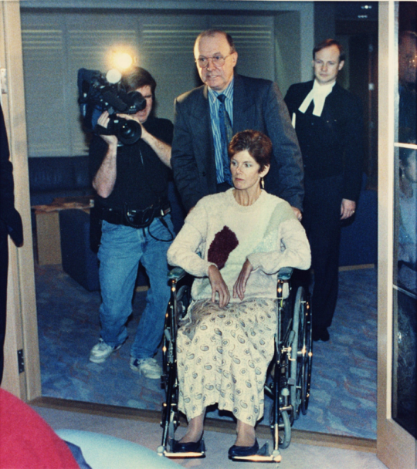
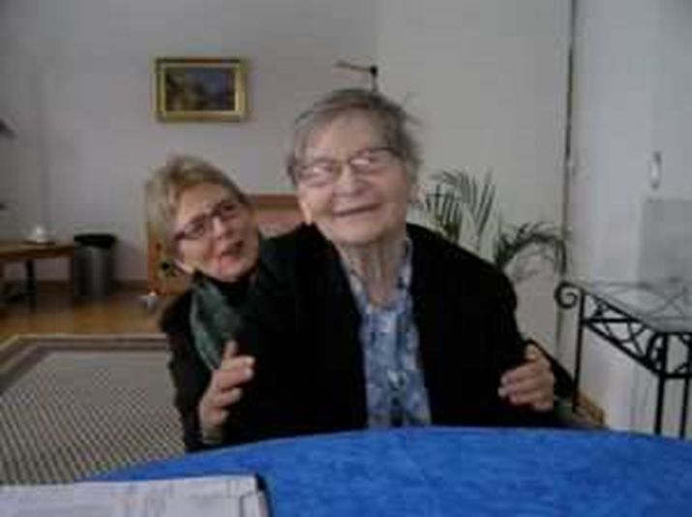
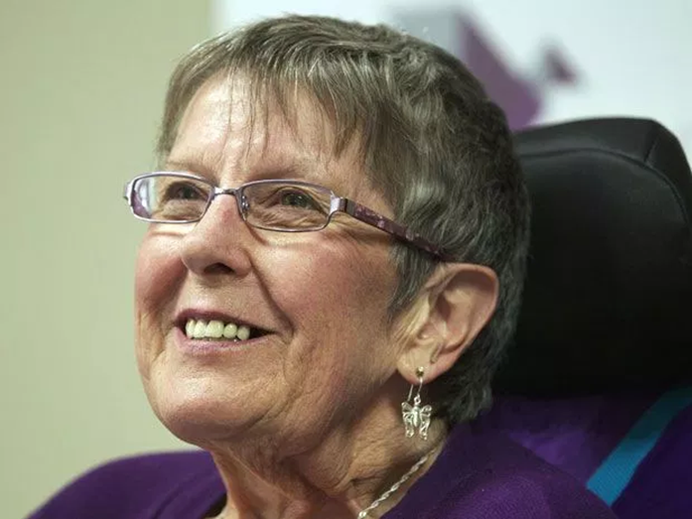
How Three Women Changed the Law
Kay Carter 89Y with spinal stenosis
Died in Switzerland 2010
Sue Rodriguez (ALS)
August 2, 1950 – February 12, 1994
Died with the assistance of an anonymous doctor
Gloria Taylor (ALS)
c. 1948 – October 4, 2012 Natural death
Notes:
Medical Assistance in Dying in Canada developed largely because of three courageous women.
Sue Rodriguez had ALS and took her request for a medically assisted death all the way to the Supreme Court of Canada, arguing that the section of the Criminal Code which prohibited assisted suicide was constitutionally invalid. In September 1993, a 5–4 majority of the Supreme Court disagreed, declaring that it was constitutional and did not violate the Canadian Charter of Rights and Freedoms. Rodriguez finally ended her life independently in February 1994, assisted by an anonymous doctor.
Despite the Supreme Court decision, the Rodriguez case played a role in changing the Canadian landscape regarding end of life choices. By the time Gloria Taylor, who also had ALS, sought a medically assisted death, she eventually succeeded in August 2012, when the BC Court of Appeal ruled in her favour, allowing her an assisted death under certain conditions. However, Gloria never actually acted on her choice, as she developed a perforated colon and died of sepsis.
Kay Carter played the final important personal role in advancing medical assistance in dying. Kay was an 89-year-old resident of a North Vancouver nursing home who suffered from chronic pain and disability from spinal stenosis. She took her request for a medically assisted death to the Supreme Court of Canada, which eventually did strike down the section of the Criminal Code which prohibited assisted suicide. Although this was too late for Kay, who ended up going to the Dignitas clinic in Switzerland for an assisted death in January 2010, her fight led the way to a new law.

Slide 18
BILL C-14(June 2016) Medical Assistance In Dying
Goal
To balance individual autonomy over the end of life decisions involving suffering with protection of society.
Concerns addressed about:
Vulnerable populations
The “slippery slope”
Care provider expectations
No requirement to formally participate in MAiD
Care providers may not abandon their patients and patients have to be allowed to seek their legal options.
https://laws-lois.justice.gc.ca/eng/annualstatutes/2016_3/fulltext.html
Notes:
Bill C 14, which came into effect in June 2016, legalized medical assistance in dying. Its goal was to balance individual autonomy over end-of-life decisions with protection of society. It addressed some concerns about vulnerable populations and the potential slippery slope towards greater eligibility over time.
Bill C 14 made clear that there was no care provider was required to formally participate in medical assistance in dying, although it also made clear that care providers should not abandon their patients and that patient should be allowed to seek their legal options.

Slide 19
Eligibility Criteria (C14 and C7)
At least 18 years old
Capacity to make decisions with respect to health
Eligible for publicly funded health care services in Canada
Make a voluntary request that is not the result of external pressure
Give informed consent to receive MAID, meaning that the person has consented to receiving MAID after they have received all information needed to make this decision
Has a grievous and irremediable medical condition:
serious and incurable illness, disease or disability (a mental illness cannot fulfill this criterion currently), and
advanced state of irreversible decline in capabilities, and
enduring physical or psychological suffering, caused by either the illness, disease or disability, or by the advanced state of decline in capabilities, that is intolerable to the person and cannot be relieved under conditions that they consider acceptable

Slide 20
Make a voluntary request that is not the result of external pressure
What if a person is unable to access necessary health of social resources to manage their suffering?
Is a request for MAID then truly voluntary?

Slide 21
Give informed consent to receive MAID, meaning that the person has consented to receiving MAID after they have received all information needed to make this decision
Is receiving information the same as understanding and retaining information?
The 95 year old woman discussed earlier was provided much information on MAID by two health care providers but was unable to recall this at the formal assessment later in the day.

Slide 22
Serious and incurable illness, disease or disability
Many illnesses, like arthritis or heart disease are not curable, but manageable.
What if a patient refuses all reasonable interventions to make these manageable?

Slide 23
Enduring physical or psychological suffering, caused by either the illness, disease or disability, or by the advanced state of decline in capabilities, that is intolerable to the person and cannot be relieved under conditions that they consider acceptable
What if an otherwise healthy person with pneumonia refuses any treatment for this as they consider the treatments unacceptable?

Slide 24
C14 required reasonably foreseeable natural death (RFND)
Natural death has become reasonably foreseeable, taking into account all of their medical circumstances, without a prognosis necessarily having been made as to the specific length of time that they have remaining
Based on Kay Carter with spinal stenosis in the initial successful court case, so likely a few years acceptable (except in Quebec)
Notes:
The concept of reasonably foreseeable natural death has been much debated. The law states that natural death has to be reasonably foreseeable, taking into account all of the patient's medical circumstances, without a prognosis necessarily having been made as to the specific length of time they have remaining.
Most practitioners use the precedent of Kay Carter, who had spinal stenosis and likely a few years of life expectancy, in their interpretation of this concept. Specifically, anticipated natural death does not have to be imminent, but likely occur within a few years and be reasonably foreseeable. There is much variation across the country and how practitioners interpret this. Some provinces such as Québec have required a fixed time such as six months, as have a few other jurisdictions.
The importance of differentiating reasonably foreseeable natural death with non-reasonable foreseeable natural death is that patients in the first category do not have an automatic waiting period and have a more straightforward assessment process. This can result in a quicker response to suffering but also potentially result in increased risks of vulnerable people who might be making impulsive decisions.

Slide 25
Origins of C-7: Truchon and Gladu v. Canada (Attorney General) and Quebec (Attorney General)
On June 13, 2017, two plaintiffs challenged both Québec’s and Canada’s MAiD legislation.
Jean Truchon and Nicole Gladu argued the laws violate their Charter rights because they are too restrictive, especially since the federal government requires that a person’s natural death has become “reasonably foreseeable” and the Quebec legislation requires that a person be at the “end of life”.
Jean Truchon had cerebral palsy; Nicole Gladu has post-polio syndrome.
End-of-Life Law and Policy in Canada. http://eol.law.dal.ca/

Slide 26
Bill C-7: An Act to Amend the Criminal Code (MAID)
Eligibility Criteria
Removal of reasonably foreseeable natural death (RFND)
Temporary exclusion of mental illness until March 17, 2023
Procedural safeguards
RFND
No mandatory waiting period, only one independent witness, can be care provider or other if no conflict of interest
Waiver of final consent
Non-RFND
90 day waiting period
Patient has to have been informed of the means available to relieve their suffering, including where appropriate, available, and applicable; counselling services, mental health and disability support services, community services and palliative care and has been offered consultations with relevant professionals who provide those service or that care
A practitioner with expertise in the condition causing the patient’s greatest suffering has been consulted to consider with the patient the reasonable and available means to relieve the patient’s suffering and the patient has given serious consideration to these means. The results of these consultations will be shared with the other assessing practitioners.
Health Canada and the Public Health Agency of Canada Presentation slides
Notes:
In March 2021 the law was amended to allow patients without recently foreseeable natural death to access medical assistance in dying.
The mandatory ten-day waiting period for patients with recently foreseeable natural death was removed and only one independent witness was required with some increased flexibility in who could be a witness.
Patients approved for medical assistance in dying in this situation could sign a waiver of final consent to allow them to receive an assisted death even if they lost capacity. This was differentiated from advanced directives in which patients might conceivably apply for medical assistance in dying before they even develop the condition underlying the request. However, the law does not specify how long in advance these requests remain valid, so each province has made its own decisions. In Saskatchewan, this request remains valid for 90 days and can be renewed once without a full additional assessment.
For patients without recently foreseeable natural death a minimum of 90 day waiting period is required, and additional requirements require that patients have to have access to appropriate specialists and that appropriate specialist opinion is solicited when this expertise in the condition underlying the request is not possessed by the assessing practitioners.
Requesting medical assistance in dying for sole mental illness was explicitly excluded, with the plan to allow this on March 17, 2023 after additional national debate and development of safeguards.

Slide 27
Reflection period and consent immediately before MAID
RFND: No reflection period , final consent can be with a written advance waiver (see next slide)
NRFND: 90 days reflection period (but this period can be shortened if the person is about to lose the capacity to make health care decisions, as long as both assessments have been completed )
Note:
The decision about eligibility does not have to be made immediately
The reflection period is not written in stone and clinical judgment should inform all decisions
Notes:
Patients with reasonably foreseeable natural death are no longer required to have a reflection period after they sign the witnessed request. Patients without reasonably foreseeable natural death are required to wait for 90 days or more after the written request. In some situations this can be shortened, particularly if the person is rapidly declining in terms of their capacity. In other situations it might be prudent to wait longer. For example, a patient may not have made all the appropriate arrangements for after the death, or dependent others such as children, may not have fully comprehended the upcoming death, and need to have more time for preparation.
Many patients apply for medical assistance in dying but do not want to act on this quickly. Many patients find considerable comfort in knowing that they have an option available to them if the dying process gets very difficult. It is not unusual that they might then die naturally with the help of other supports such as palliative care. The main goal of medical assistance in dying is to ensure a peaceful, humane death, so this is also a very reasonable option.

Slide 28
Waiver of final consent (Advance Consent Arrangement or ACA in Saskatchewan)
Person’s natural death must be reasonably foreseeable;
Person must be assessed as eligible for MAID and MAID procedure must be scheduled (Maximum of 90 days from signing in Saskatchewan);
Person must be informed that they are at risk of losing decision-making capacity before the scheduled date;
Person gives consent in writing to receive MAID on the scheduled day if they are no longer able to consent on that day (this waives the requirement that consent be expressed immediately before MAID is provided).
Practitioner must agree to provide MAID on the scheduled day if patient has lost capacity (or earlier, after loss of capacity, if agreed)
Adapted from: Health Canada and the Public Health Agency of Canada Presentation slides

Slide 29
Waiver of final consent (Advance Consent Arrangement or ACA in Saskatchewan)
If, on the day of MAID procedure, the person has capacity to consent to MAID, the practitioner must give the person the opportunity to withdraw their request and ensure that the person gives express consent to receive MAID
If, on the day of MAID procedure, the person has lost capacity to consent to MAID, the practitioner can provide MAID on the basis of the written consent as agreed to earlier:
Consent given in advance is invalidated if the person demonstrates, by words or gestures, refusal or resistance to the administration of MAID at the time of the procedure.
Involuntary words, sounds or gestures made in response to contact do not constitute a demonstration of refusal or resistance
Adapted from: Health Canada and the Public Health Agency of Canada Presentation slides

Slide 30
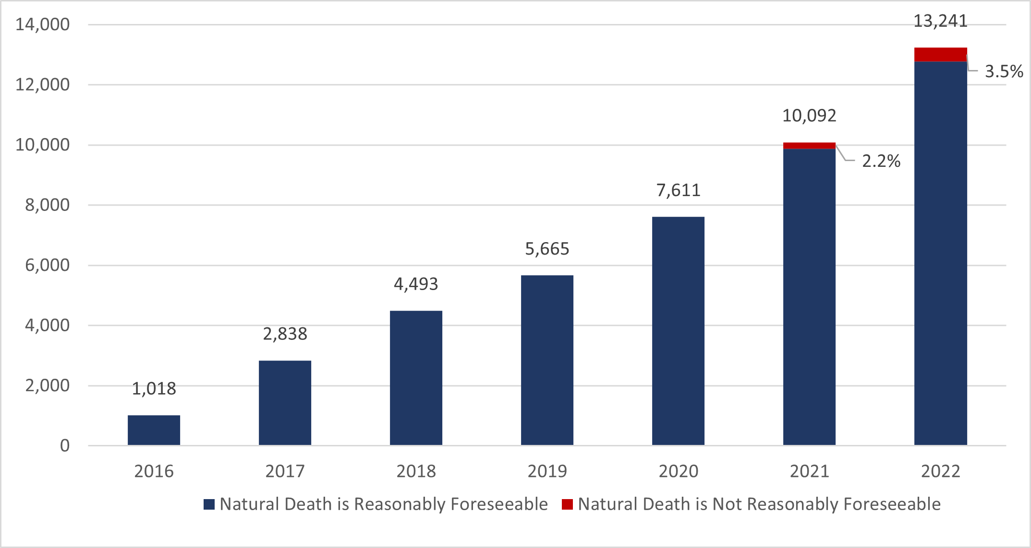
Total MAID Deaths in Canada, 2016 to 2022

Slide 31
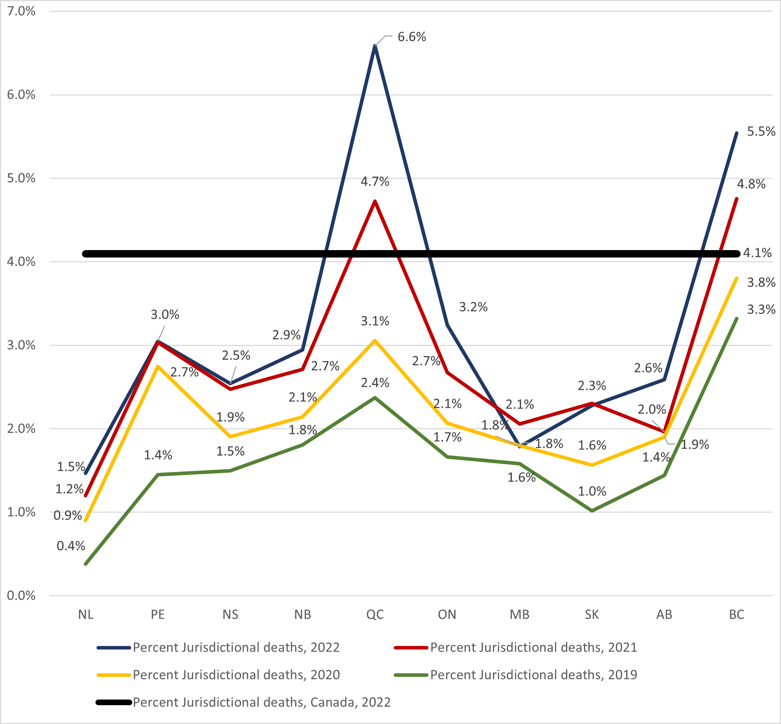
Percentage of Total Deaths Attributed to MAID by Jurisdiction, 2019 - 2022

Slide 32
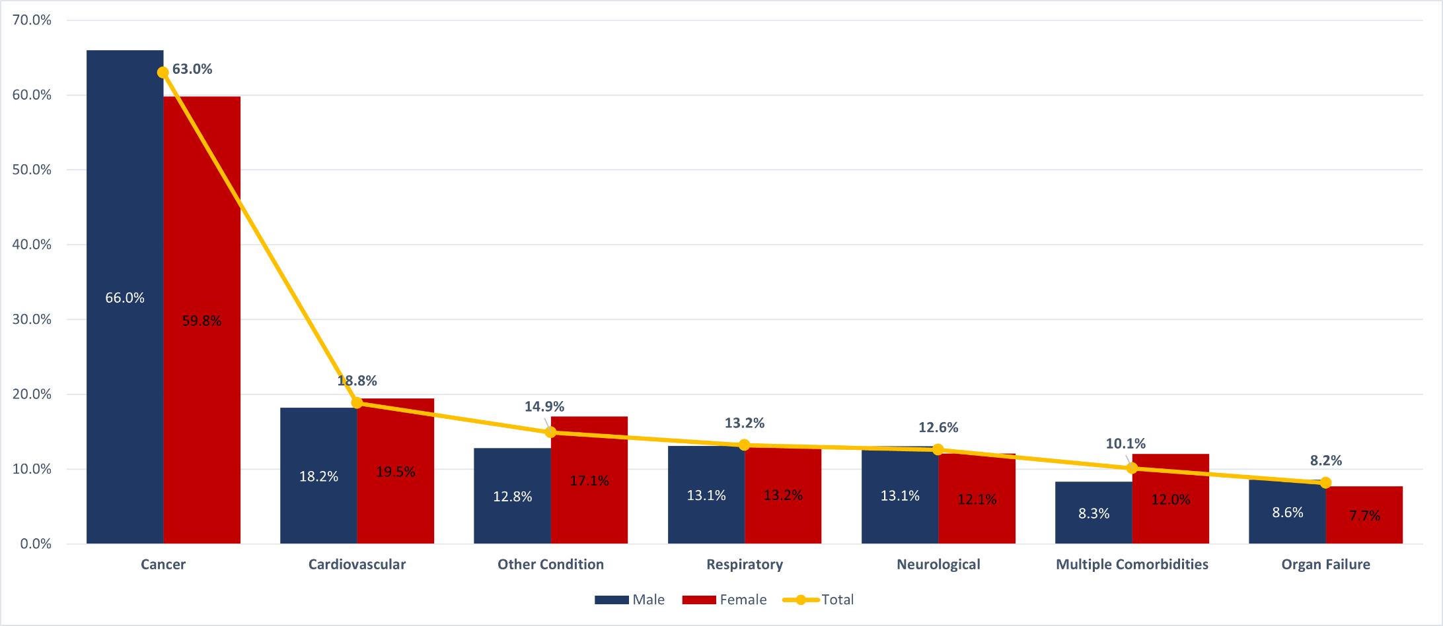
MAID by Main Condition, 2022

Slide 33
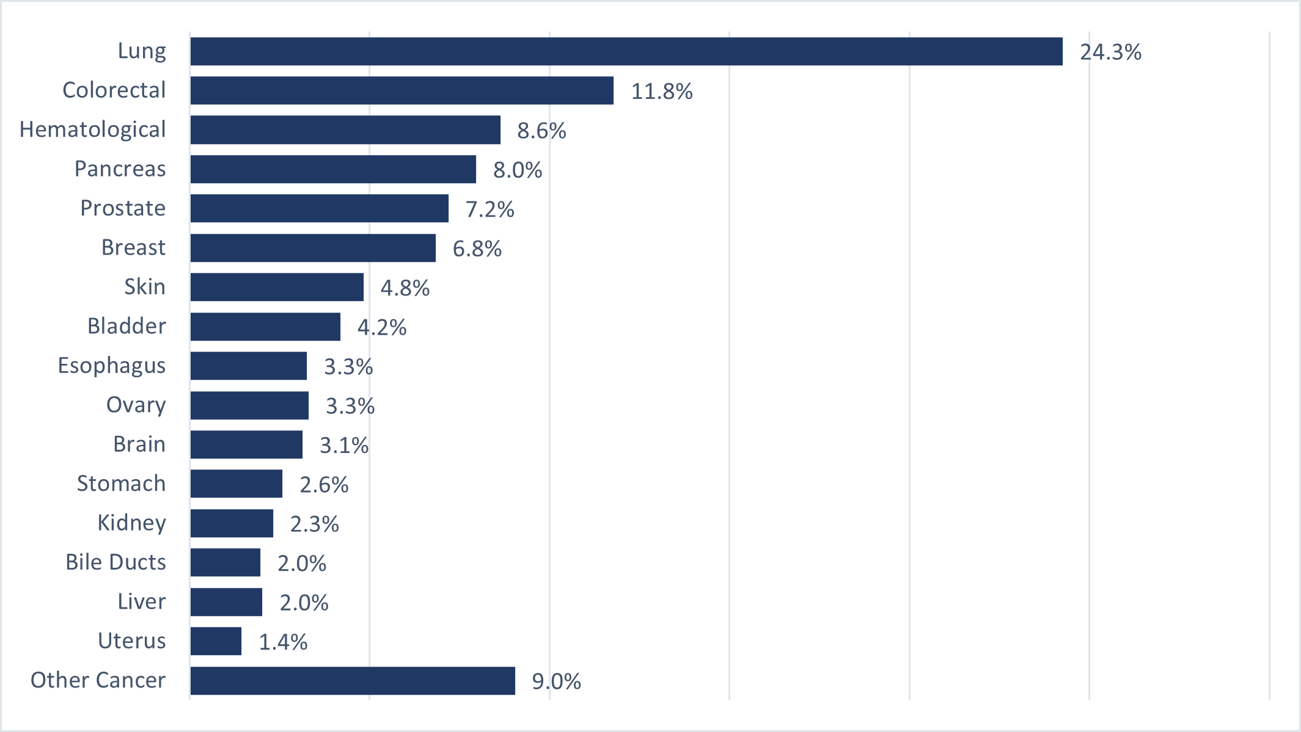
MAID by Cancer Type, 2022

Slide 34
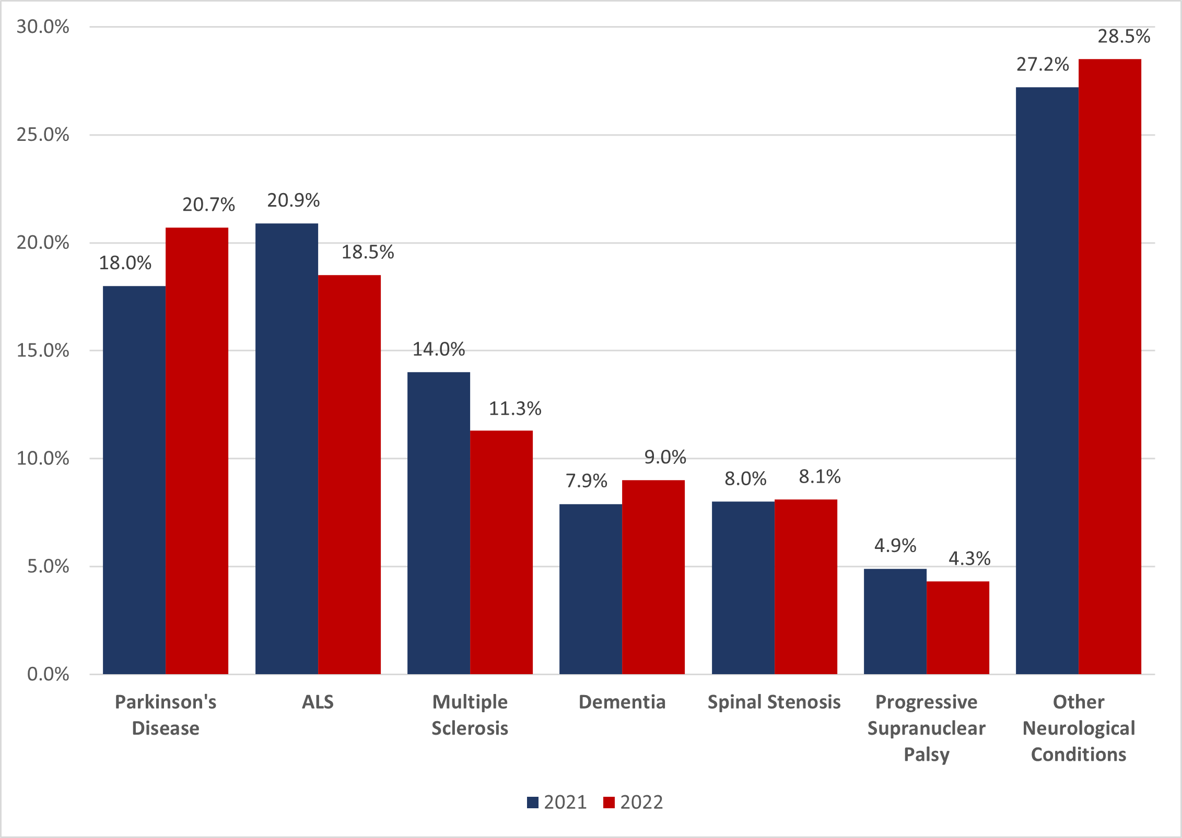
MAID by Neurological Condition, 2021-2022

Slide 35
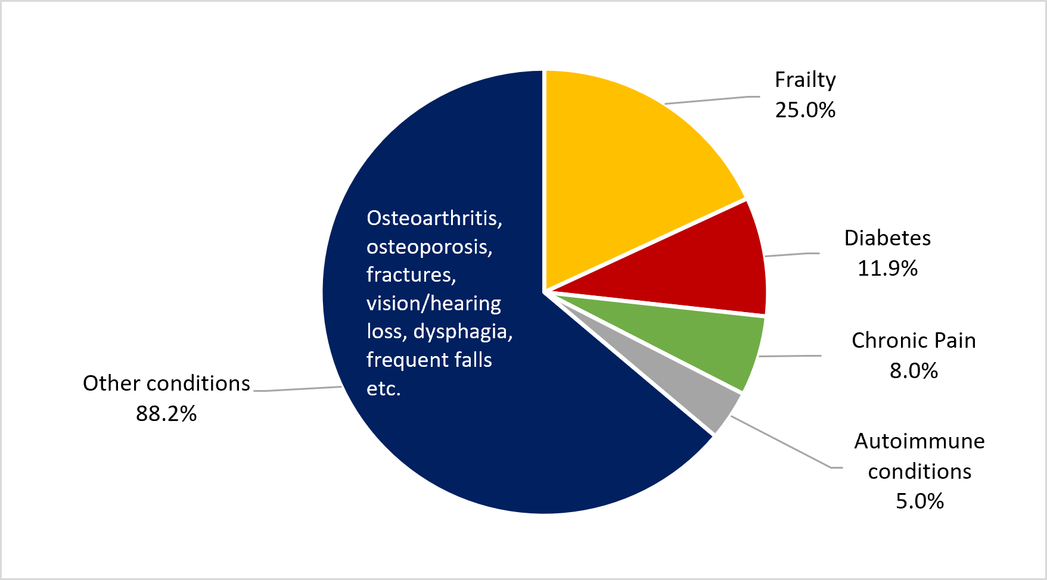
MAID by Other Condition / Multiple Comorbidities, 2022

Slide 36
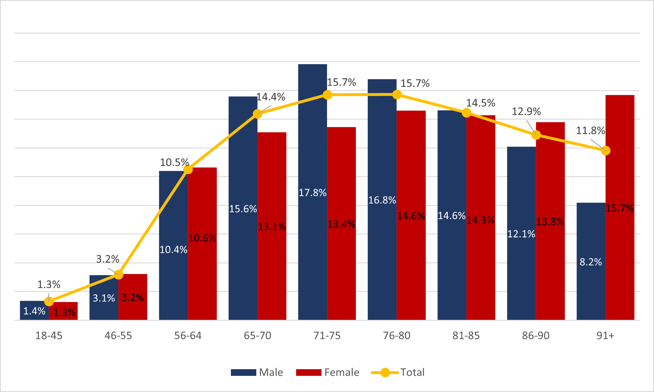
MAID by Age Category, 2022

Slide 37
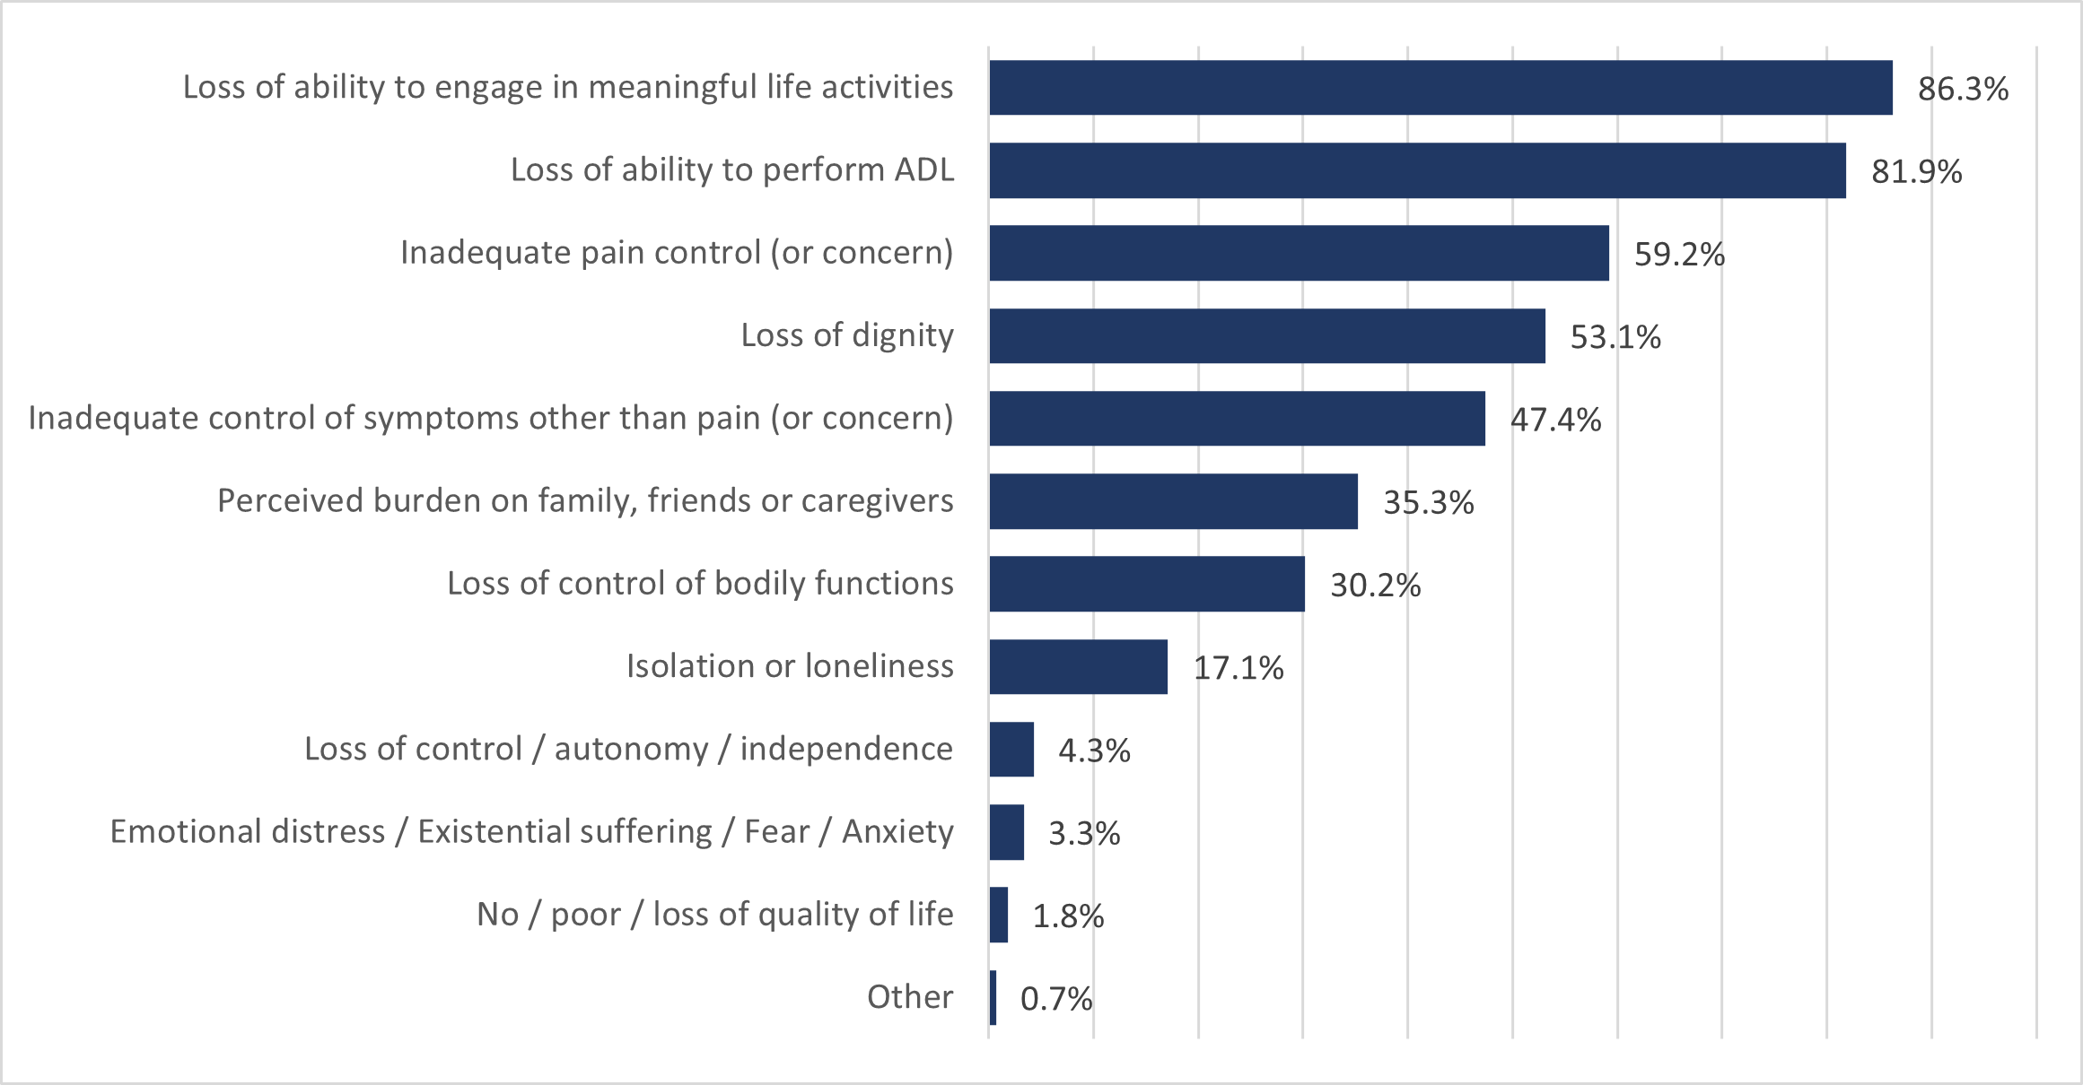
Nature of Suffering of Those Who Received MAID, 2022

Slide 38
MAID Recipients Who Received Palliative Care and Disability Support Services, 2022
Palliative care was accessible if needed | 2250 | 87.5% | Persons who required but did not receive disability support services | 196 | 4.1%
 |  |  | Disability support services were accessible if needed | 147 | 75.%

Slide 39
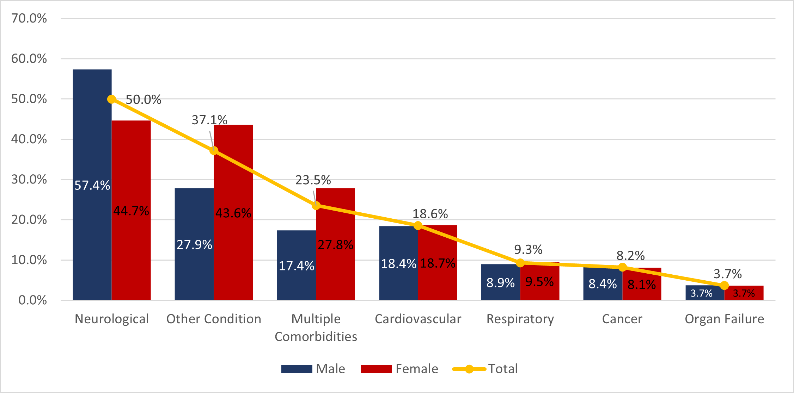
Main Condition, MAID, Natural Death Not Reasonably Foreseeable, 2022

Slide 40
Patients asking for a medically assisted death
RFND
(Assisted dying)
Cancer
Other including CV, Respiratory, neurological (ALS, PD)
Not RFND examples (Assisted suicide?)
Morbid obesity
Cerebral palsy, cystic fibrosis
Spinal cord and other injuries
Crohn’s disease
Tinnitus, vertigo
Chronic pain
Others
Notes:
The main conditions underlying the request for medical assistance in dying appear to be different for those with and without reasonably foreseeable natural death.
Although only a small amount of data is available, underlying health conditions include more chronic illnesses. In our community we have seen conditions such as morbid obesity, cerebral palsy, cystic fibrosis, spinal cord injuries, inflammatory bowel disease, chronic pain, tinnitus, and vertigo as underlying health conditions for people without reasonably foreseeable natural death.
Patients with recently foreseeable natural death are generally termed as being on track I, whereas those without reasonably foreseeable natural death are termed as being on track II.

Slide 41
Special issues in those without RFND
Frequent long-standing social isolation with disconnection from social and occupational networks
Decreased normative feedback from others about dysfunctional thinking patterns
Decreased knowledge about possible interventions and possible supports or mistrust of health system and treatments (i.e internet source of information)
Increasing, long-standing demoralization and poor self-esteem
Poor coping skills, impaired executive functioning
Limited available supports in the community Frequent comorbid mental illness including personality disorders
Notes:
Track II patients appear also to be a more vulnerable group. Based on early experience, many of these patients have been affected by long-standing social isolation with disconnection from social and occupational networks, frequently due to chronic medical or mental illness. This can result in decreased normative feedback from others about dysfunctional thinking patterns.
For example, difficult circumstances can be personalized excessively, with guilt and self blame resulting in increased distress. Supportive others can help supply other interpretations of the events, resulting in decreasing this distress.
Social isolation can also result in decreased knowledge about potential interventions and supports as well as distrust of the healthcare system and its treatments, especially if the source of information is largely from social media.
Track two patients often have long-standing demoralization and poor self-esteem. They may have poor coping skills and impaired executive functioning, with limited support in the community. It appears to be more common for these patients to have more comorbid mental illness including personality disorders which results in greater dissatisfaction and unhappiness with their life circumstances.

Slide 42
MAID for sole or comorbid mental disorders
MD-SUMC: Mental disorder is the sole underlying medical condition.
Recently deferred for three years:
Bill C-62 An Act to amend An Act to amend the Criminal Code (medical assistance in dying), No. 2
Requires that a joint parliamentary committee undertake a comprehensive review relating to the eligibility for MAID of persons suffering solely from a mental illness within two years of the Bill receiving royal assent
MAID and mental disorders: the road ahead. Report of the Special Joint Committee Medical Assistance in Dying. René Arseneault & Honourable Yonah Martin Joint Chairs, January 2024
Notes:
On February 29, 2024, legislation to extend the temporary exclusion of eligibility to receive MAID in circumstances where a person's sole underlying medical condition is a mental illness received royal assent and immediately came into effect. The eligibility date for persons suffering solely from a mental illness is now March 17, 2027.
https://www.justice.gc.ca/eng/csj-sjc/pl/charter-charte/c62.html
The Government of Canada introduces legislation to delay Medical Assistance in Dying expansion by 3 years The Government of Canada introduces legislation to delay Medical Assistance in Dying expansion by 3 years - Canada.ca
Under Canada's current MAID law, people suffering solely from a mental illness who meet all the eligibility criteria and safeguards would have been eligible for MAID as of March 17, 2024. Important progress has been made to prepare for MAID eligibility for persons whose sole medical condition is a mental illness. However, in its consultations with the provinces, territories, medical professionals, people with lived experience and other stakeholders, the Government of Canada has heard – and agrees – that the health system is not yet ready for this expansion.
That is why today, the Honourable Mark Holland, Minister of Health, who was joined by the Honourable Ya'ara Saks, Minister of Mental Health and Addictions and Associate Minister of Health, and the Honourable Arif Virani, Minister of Justice and Attorney General of Canada, introduced legislation proposing to extend the temporary exclusion of eligibility for MAID for persons suffering solely from a mental illness for three years. This extension would provide more time for provinces and territories to prepare their health care systems, including the development of policies, standards, guidance and additional resources to assess and provide MAID in situations where a person's sole underlying medical condition is a mental illness. It would also provide practitioners with more time to participate in training and become familiar with available supports, guidelines and standards.
This proposed delay is also in line with the recommendations of the Special Joint Committee on MAID (AMAD) in their report MAID and Mental Disorders: The Road Ahead, which was tabled on January 29, 2024. While recognizing that considerable progress has been made in preparing for the expansion of eligibility for persons suffering solely from a mental illness, AMAD recommended that it not be made available in Canada until the health care system can safely and adequately provide MAID for these cases.
The Government of Canada is also proposing that a joint parliamentary committee undertake a comprehensive review relating to the eligibility for MAID of persons whose sole underlying medical condition is a mental illness, within two years after the Act receives royal assent. This measure would further serve to examine progress made by provinces, territories, and partners, in achieving overall health care system readiness.
The Government of Canada is committed to a measured, thoughtful and compassionate approach to help ensure Canada's MAID system meets the needs of people in Canada, protects those who may be vulnerable, and supports autonomy and freedom of choice of individuals. We will continue to work with the provinces and territories, medical professionals, people with lived experiences, and other stakeholders to support the safe implementation of MAID, with appropriate safeguards in place, to affirm and protect the inherent and equal value of every person's life.

Slide 43
The special joint committee on medical assistance in dying. Third report, January 2024
WHEREAS the Committee concludes that the medical system in Canada is not prepared for medical assistance in dying where mental disorder is the sole underlying medical condition (hereinafter “MAID MD-SUMC”), the committee recommends:
That MAID MD-SUMC should not be made available in Canada until the Minister of Health and the Minister of Justice are satisfied, based on recommendations from their respective departments and in consultation with their provincial and territorial counterparts and with Indigenous Peoples, that it can be safely and adequately provided; and
That one year prior to the date on which it is anticipated that the law will permit MAID MD-SUMC, pursuant to subparagraph (a), the House of Commons and the Senate re-establish the Special Joint Committee on Medical Assistance In Dying in order to verify the degree of preparedness attained for a safe and adequate application of MAID MD-SUMC.
https://publications.gc.ca/collections/collection_2024/sen/yc3/YC3-441-0-2-3-eng.pdf

Slide 44
The Major Concerns About MAiD MD-SUMC*
Similar in many other chronic conditions
Difficulty predicting with certainty the evolution of an individual’s mental disorder or an individual’s ability to adapt to the condition
Incurability
Irreversibility of functional impact
Intolerability of suffering
Capacity
Suicidality: differentiation from a MAID request
Intersection of structural vulnerability, mental disorder and MAiD
*MD-SUMC: mental disorder is sole underlying medical condition. Deferred til Mar 2024
Final Report of the Expert Panel on MAiD and mental illness. May 2022

Slide 45
Recommendations by the Expert Panel
Development of MAID practice standards
Establishing incurability
Establishing irreversibility
Understanding enduring and intolerable suffering
Comprehensive capacity assessments
Means available to relieve suffering
Interpretation of track II safeguard the person has given serious consideration to those means
Consistency, durability, and well-considered nature of a MAID request
Situations of involuntariness
Final Report of the Expert Panel on MAiD and mental illness. May 2022

Slide 46
General concerns about voluntariness in the context of mental disorders
Internal pressure
Persistent beliefs about one’s worthlessness
Depression
Early life trauma
A person might understand and appreciate the risks and benefits of certain treatments but hold self-denigrating beliefs that they are not deserving of treatment or care.
Whether such beliefs affect voluntariness must be assessed on case by case basis.
The Canadian MAID Curriculum mental illness working group

Slide 47
Voluntariness of a request for MAID
As in all clinical care, MAID assessors and providers must be satisfied that the person’s decision to request MAID has been made freely, without undue influence (contemporaneous or past) from family members, health care providers, or others.
Undue influence occurs when a person is not able to act in their own interests because of the interference by others.
This undue influence may occur as a result of current or past pressure. For example, past abusive relationships may have been sufficiently severe that the person is not able to do what is good for them, but rather evaluates decisions according to what the abuser thinks or thought was good for them. However, having experienced trauma does not mean that that one cannot make a voluntary request.
Health Canada MAID Practice Standards Task Group

Slide 48
Voluntariness of a request for MAID
The practitioner must assess whether the voluntariness of a person’s request has been compromised (e.g., by incentives or threats). Practitioners should speak with the requester alone as part of the assessment process. If that is not possible because the requester requires supports (whether physical supports or for communication), the person providing support should not be someone who might be a source of undue influence.
The practitioner should ask questions that will help to identify undue influence, such as interpersonal dependencies or past abuse that may leave the requester vulnerable. The practitioner should take steps to eliminate threats to voluntariness, and this may require serial assessments.
A person’s request may not be voluntary at one time, but voluntary at a later time and vice versa.
The assessor and provider must be satisfied the request is voluntary when it is made and the provider must be satisfied it is voluntary when MAID is provided.
Health Canada MAID Practice Standards Task Group

Slide 49
Time requirement for adequate assessment
The assessment period for patients who do not have a RFND is a MINIMUM of 90 days.
Time necessary to conduct a thorough assessment might be very considerable.
The Euthanasia Expertise clinic in the Netherlands which sees approximately 85% of the requests in the country motivated by mental disorders, takes on average 10 months to complete an assessment of this type of request. Kammeraat, M., & Kölling, P. (2020).
Adapted from: The Canadian MAID Curriculum mental illness working group

Slide 50
Most Common Mental Disorders in MAID Requests based on European data on MAID-MD
Mood disorders – 50-70%
Personality disorders – (most common condition comorbid with other psychiatric conditions (52-54%)
Autism Spectrum (One of the most common of the 12.3% “another psychiatric disorder”)
Comorbidity is the rule – (56-97% at least two psychiatric disorders)
*
The Canadian MAID Curriculum mental illness working group
Notes:
Thienpont L, Verhofstadt M, Van Loon T, Distelmans W, Audenaert K, De Deyn PP. Euthanasia requests, procedures and outcomes for 100 Belgian patients suffering from psychiatric disorders:
a retrospective, descriptive study. BMJ Open. 2015 Jul 27;5(7):e007454. doi: 10.1136/bmjopen-2014-007454. PMID: 26216150; PMCID: PMC4530448.
** Verhofstadt Thesis
***Dierickx S, Deliens L, Cohen J, Chambaere K. Euthanasia for people with psychiatric disorders or dementia in Belgium: analysis of officially reported cases.
MC Psychiatry. 2017;17(1):203. doi:10.1186/s12888-017-1369-0
****Calati R, Olié E, Dassa D, et al. Euthanasia and assisted suicide in psychiatric patients: A systematic review of the literature. J Psychiatr Res. 2021;135:153-173.
doi:10.1016/j.jpsychires.2020.12.006

Slide 51
Health Canada MAID Practice Standards Task Group
Mona Gupta- University of Montreal
Jocelyn Downie- Dalhousie University
Gus Grant- College of Physicians and Surgeons, NS
Laurel Plewes- Director of the Assisted Dying Program, BC
Willi Kirenko- NP Ontario
Lilian Thorpe- University of Saskatchewan
Abby Hoffman- Health Canada
Health Canada MAID Practice Standards Task Group

Slide 52
Health Canada MAID Practice Standards Task Group
Model Practice Standard for Medical Assistance in Dying (MAID)
Advice to the Profession: Medical Assistance in Dying (MAID)
Notes:
Health Canada. Model Practice Standard for Medical Assistance in Dying (MAID).
https://www.canada.ca/en/health-canada/services/publications/health-system-services/model-practice-standard-medical-assistance-dying.html
Health Canada. Advice to the Profession: Medical Assistance in Dying (MAID)
https://www.canada.ca/en/health-canada/services/publications/health-system-services/advice-profession-medical-assistance-dying.html

Slide 53
Before providing MAID to a person whose natural death is not reasonably foreseeable taking into account all of their medical circumstances (Track 2), the provider must:
If neither they nor the assessor has expertise in the condition that is causing the person’s suffering, ensure that they or the assessor consults with a physician or nurse practitioner who has that expertise and shares the results of that consultation with the other practitioner (see section 10.3.7 for further content on ‘expertise’);
Ensure that the person has been informed of the means available to relieve their suffering, including, where appropriate, counselling services, mental health and disability support services, community services, and palliative care and has been offered consultations with relevant professionals who provide those services or that care;
Bill C-7

Slide 54
Practitioner with expertise
A ‘practitioner with expertise’ is not required to have a specialist designation. Rather, expertise can be obtained through physician or nurse education, training, and substantial experience in treating the condition causing the person’s suffering.
[Physicians/Nurse Practitioners] must ensure that they have the expertise necessary to provide the consultation. In doing so, they must work within their scope of practice.
The ‘practitioner with expertise’ under this provision of the Criminal Code is providing a consultation to the assessor and provider, not a MAID eligibility assessment.
A review of the requester’s prior health records (including past specialist consultation reports) can be an important part of a complete MAID eligibility assessment.
However, such a review does not constitute ‘consultation’ for the purposes of section 10.2.6 as that requires direct contemporaneous communication with the practitioner with expertise.
Health Canada MAID Practice Standards Task Group

Slide 55
Eligibility for MAID: Grievous and irremediable medical condition
They have a serious and incurable illness disease, or disability (NOT sole mental disorder until March 2024); AND
They are in an advanced state of irreversible decline in capability; AND
That illness, disease, or disability or that state of decline causes them enduring physical or psychological suffering that is intolerable to them and that cannot be relieved under conditions that they consider acceptable
Bills C14 and C-7
Notes:
Patients eligible for medical assistance in dying had to have a grievous and irremediable medical condition. This was defined as:
1. Having a serious and incurable illness, disease, or disability
2. Being in an advanced state of irreversible decline in capability
3. That illness, disease, or disability or that state of decline causes them enduring physical or psychological suffering that is intolerable to them and that cannot be relieved under conditions that they consider acceptable
Note that the underlying illness causing the disability was not to be a sole mental disorder.
Challenges with this definition are that patients might well decline treatments that might successfully treat their underlying illness, and result in them having many additional years of productive life. Making this choice could be strongly affected by underlying mental conditions or difficult socioeconomic circumstances.

Slide 56
Serious and incurable illness, disease, or disability
‘Incurable’ means there are no reasonable treatments remaining where reasonable is determined by the clinician and person together exploring the recognized, available, and potentially effective treatments in light of the person’s overall state of health, beliefs, values, and goals of care.
At the time of the MAID eligibility assessment, assessors and providers should explore treatment attempts made up to that point including their duration and intensity, outcomes of those treatments, and severity and duration of illness, disease, or disability.
Note that it is the assessor and provider who must be of the opinion that the person has a serious and incurable illness, disease, or disability.
Health Canada MAID Practice Standards Task Group

Slide 57
Serious and incurable illness, disease, or disability
The incurability of the illness, disease, or disability does not require that a person has attempted every potential option for intervention irrespective of the potential harms, nor that a person must attempt interventions that exist somewhere in the world but are inaccessible to them.
At the same time, a capable person cannot refuse all or most interventions and automatically render themselves incurable for the purposes of accessing MAID.
An assessor or provider cannot form an opinion about MAID eligibility in the absence of evidence required to form that opinion, i.e., that there are no reasonable treatments remaining where reasonable is determined through a process of the clinician and patient together exploring the recognized, available, and potentially effective treatments in light of the patient’s overall state of health, beliefs, values, and goals of care.
Health Canada MAID Practice Standards Task Group

Slide 58
An advanced state of irreversible decline in capability
Capability refers to a person’s functioning (physical, social, occupational, or other important areas), not the symptoms of their condition. Function refers to the ability to undertake those activities that are meaningful to the person.
Advanced state of decline’ means the reduction in function is severe.
Irreversible’ means there are no reasonable interventions remaining where reasonable is determined by the clinician and person together exploring the recognized, available, and potentially effective interventions in light of the person’s overall state of health, beliefs, values, and goals of care.
Health Canada MAID Practice Standards Task Group

Slide 59
An advanced state of irreversible decline in capability
At the time of the MAID eligibility assessment, assessors and providers should explore attempts at interventions made up to that point, outcomes of those interventions, and severity and duration of illness, disease, or disability.
How many interventions, how many kinds of interventions, and over what period of time will vary according to the requester’s baseline function as well as functional goals.
The irreversibility of decline does not require that a person has attempted every potential intervention irrespective of the potential harms, nor that a person must attempt interventions that exist somewhere in the world but are inaccessible to them. At the same time, a capable person cannot refuse all or most interventions and automatically render themselves in an advanced state of irreversible decline for the purposes of accessing MAID.
An assessor or provider cannot form an opinion about MAID eligibility in absence of the evidence required to form that opinion, i.e., that there are no reasonable interventions remaining where reasonable is determined through a process of the clinician and patient together exploring the recognized, available, and potentially effective interventions in light of the patient’s overall state of health, beliefs, values, and goals of care.
Health Canada MAID Practice Standards Task Group

Slide 60
Suffering that is intolerable to them and that cannot be relieved under conditions that they consider acceptable
For the purposes of forming the opinion that the suffering criterion for MAID is met, providers and assessors:
(a) must be of the opinion that it is the person’s illness, disease, or disability and/or state of decline in capability that is the cause of the person’s suffering;
(b) must be of the opinion that the suffering is enduring;
(c) must respect the subjectivity of suffering;
(d) must explore all dimensions of the person’s suffering (physical, psychological, social, existential and the means available to relieve them); and
(e) must explore the consistency of the person’s assessment of their suffering with the person’s overall clinical presentation, expressed wishes over time, and life narrative.
Health Canada MAID Practice Standards Task Group

Slide 61
Serious consideration to the reasonable and available means to relieve the person’s suffering (Track II)
Before a [physician/nurse practitioner] provides MAID, they must ensure that they and the second assessor have discussed with the person the reasonable and available means to relieve the person’s suffering and they and the second assessor agree with the person that the person has given serious consideration to those means.
Serious consideration must be understood to mean: a) exercising capacity, not merely having it; b) exhibiting careful thought; and c) not being impulsive
Health Canada MAID Practice Standards Task Group

Slide 62
“Bob” 56 YO Indigenous man in homeless shelter asks for MAID
Medical issues treated in hospital 2020: Diabetes, diabetic neuropathy with chronic pain (previously treated with pregabalin), peripheral vascular disease, below knee amputation, chronic depression and suicidality (previously seen by psychiatry and started on escitalopram), renal failure on dialysis.
Became homeless, no family physician, ended up at homeless shelter, no GP, NO MEDS and asked for MAID with complaints of terrible pain and evidence of ongoing depressive symptoms. Not aware that homeless shelter had a NP visiting weekly and a GP every two weeks.
Is Bob eligible for MAID?

Slide 63
Bob- Eligibility Criteria (C14 and C7)
At least 18 years old YES
Capacity to make decisions with respect to health
Questionable due to knowledge deficits
Eligible for publicly funded health care services in Canada YES
Make a voluntary request that is not the result of external pressure.
Rationality and stability of request is highly questionable. Impacted by depression, demoralization, and external pressure consisting of psychosocial circumstances (lack of access to any care). See next slide
Give informed consent to receive MAID, meaning that the person has consented to receiving MAID after they have received all information needed to make this decision.
Unaware he had access to NP and GP follow-up at the shelter with resumption of medications to treat his pain and depression

Slide 64
Capacity and informed consent: CPSS
Capable: The person is able to understand information that is relevant to making decisions and is also able to appreciate the reasonably foreseeable consequences of either making or not making a decision.
Capacity: The ability:
To understand information relevant to a health care decision respecting a proposed treatment;
To appreciate the reasonably foreseeable consequences of making or not making a health care decision respecting a proposed treatment; and
To communicate a health care decision with respect to a proposed treatment.
Consent: the voluntary agreement to or acquiescence in what another person proposes or desires; agreement as to a course of action
College of Physicians and Surgeons of Saskatchewan

Slide 65
Factors to consider in exploring capacity and informed consent: CPSS
Evidence of confused or delusional thinking;
An appearance of an inability to make a settled choice about treatment;
Severe pain or acute fear or anxiety;
The appearance of severe depression;
The appearance of impairment by alcohol or drugs;
Any other observations which give rise or a concern about the person’s behaviour or communication;
Evidence of significant intellectual disability;
Evidence of impairment of executive function, or mild cognitive impairment; or,
Evidence the person is unduly under the influence of another person.
College of Physicians and Surgeons of Saskatchewan

Slide 66
Informed consent for MAID: CPSS
Each physician who obtains informed consent from the patient for medical assistance in dying must:
Inform the patient of:
Material information which a reasonable person in the patient’s position would want to have about medical assistance in dying;
The material risks associated with the provision/administration of the pharmaceutical agent(s) that will intentionally cause the patient's death; and
Meet with the patient separate from family members or others who may influence the patient’s decision at least once to confirm that his/her decision to terminate his/her life by medical assistance in dying is voluntary and that the patient has:
Made the request him/herself thoughtfully; and
A clear and settled intention to end his/her own life by medical assistance in dying after due consideration;
Made the decision freely and without coercion or undue influence from family members, health care providers or others.
College of Physicians and Surgeons of Saskatchewan

Slide 67
Capacity, vulnerability, voluntariness and informed consent
Emotional states, vulnerability and cognitive distortions
Cognitive decision-making capacity (at a particular time and in a particular context)
Knowledge provision, comprehension and retention
External influences
Informed (competent) decision
Voluntariness?

Slide 68
Vulnerability and MAiD Requests
Vulnerability regarding MAiD occurs when a person is at risk of requesting and receiving MAiD because of the influence of factors other than or in addition to the underlying grievous and irremediable medical condition
Internal factors may include personality, persistent depressive disorder, psychosis, physical pain, physical health, and trauma history.
External factors may include coercion from others, structural vulnerability in social supports, economic resources, discrimination, and accessibility of resources
Vulnerability may influence voluntariness and impair the patient from providing free and informed consent.
Patients are not eligible if a vulnerability outside of or incidental to the medical condition or state of decline is the main cause of the suffering.
In all persons with vulnerabilities who are requesting MAiD, it is necessary to ensure first that any available means to mitigate these vulnerabilities is presented to reduce suffering when possible.
Adapted from CAMAP MAID module, working group IV

Slide 69
Sources of Vulnerability
Capacity (emotional state, cognitive abilities), poor coping skills, trauma history, low self-worth, and negative interactions with medical system.
Abuse/victimization, absence of social support, communication skills, relationship with clinicians, and caregiver burnout.
Employment/volunteer work, economic security, housing/food, lack of access to treatment/supports/resources such as mental health support, pain management and palliative care, as well as lack of access to MAiD
Stigma, discrimination, racism and oppression, and inaccessible work and social environments
Adapted from CAMAP MAID module, working group IV

Slide 70
Autonomy-Protection Continuum
Know where your values lie on the continuum of prioritizing autonomy vs protection
How does this change in different clinical contexts?
Autonomy
Protection

Slide 71
How do you differentiate a MAID request from suicidality?
Health Canada MAID Practice Standards Task Group
Providers and assessors should ensure that the person’s request for MAID is consistent with the person’s values and beliefs, unambiguous, enduring, and rationally considered during a period of stability, and not during a period of crisis. This may require serial assessments
Bob’s situation
Clearly not stable and in crisis due to loss of access to medications to treat his symptoms
Health Canada MAID Practice Standards Task Group

Slide 72
Eligibility for MAID: Grievous and irremediable medical condition
They have a serious and incurable illness disease, or disability (NOT sole mental disorder until March 2024); AND
They are in an advanced state of irreversible decline in capability; AND
That illness, disease, or disability or that state of decline causes them enduring physical or psychological suffering that is intolerable to them and that cannot be relieved under conditions that they consider acceptable
Bills C14 and C-7
Notes:
Challenges with this definition are that patients might well decline treatments that might successfully treat their underlying illness, and result in them having many additional years of productive life. Making this choice could be strongly affected by underlying mental conditions or difficult socioeconomic circumstances.

Slide 73
Bob: Eligibility for MAID- A: Grievous and irremediable medical condition
They have a serious and incurable* illness disease, or disability (NOT sole mental disorder currently);
‘Incurable’ means there are no reasonable treatments remaining where reasonable is determined by the clinician and person together exploring the recognized, available, and potentially effective treatments in light of the person’s overall state of health, beliefs, values, and goals of care. (Health Canada Practice standard)
YES (diabetes, peripheral vascular disease, renal failure)
Bills C14 and C-7

Slide 74
Bob- B: They are in an advanced state of irreversible decline in capability
Capability refers to a person’s functioning (physical, social, occupational, or other important areas), not the symptoms of their condition. Function refers to the ability to undertake those activities that are meaningful to the person.
‘Advanced state of decline’ means the reduction in function is severe.
‘Irreversible’ means there are no reasonable interventions remaining where reasonable is determined by the clinician and person together exploring the recognized, available, and potentially effective interventions in light of the person’s overall state of health, beliefs, values, and goals of care.
It is the assessor and provider who must be of the opinion that the person is in an advanced state of irreversible decline in capability
Bob:
Might his function improve if receiving his antidepressants and pain medications? He is NOT declining these, but lost access to them
How would you know if this is irreversible unless he get access to care again?
Health Canada MAID Practice Standards Task Group

Slide 75
Bob- C: Intolerable suffering
Health Canada Practice Standard: Assessors/providers:
Must explore all dimensions of the person’s suffering (physical, psychological, social, existential) and the means available to relieve them;
Must explore the consistency of the person’s assessment of their suffering with the person’s overall clinical presentation, expressed wishes over time, and life narrative;
Bob didn’t express this suffering when in hospital receiving his medications
Must be of the opinion that it is the person’s illness, disease, or disability and/or state of decline in capability that is the cause of the person’s suffering;
Bob: is the suffering largely caused by lack of access to medical care?
Must be of the opinion that the suffering is enduring;
Must respect the subjectivity of suffering.

Slide 76
Means that could relieve suffering are not available due to systemic barriers
As in all clinical practice, practitioners must navigate these tensions by focusing on informing requesters about all available options and doing whatever is in their power to remove barriers and biases encountered by individual requesters.
Bob:
Is finding BOB eligible without any attempt to connect him with available resources consistent with ethical or professional standards?
Resources were actually found to be available with minimal effort to the assessor
Health Canada MAID Practice Standards Task Group

Slide 77
Bob continued: If he is deemed track II or not reasonably foreseeable natural death. Who should you choose to supply expertise?
Patient has to have been informed of the means available to relieve their suffering, including where appropriate, available, and applicable; counselling services, mental health and disability support services, community services and palliative care and has been offered consultations with relevant professionals who provide those service or that care
A practitioner with expertise in the condition causing the patient’s greatest suffering has been consulted to consider with the patient the reasonable and available means to relieve the patient’s suffering and the patient has given serious consideration to these means. The results of these consultations will be shared with the other assessing practitioners.
Health Canada and the Public Health Agency of Canada Presentation slides

Slide 78
What is Bob refuses access to Health records?
(a) Assessors and providers must attempt to obtain all health records and personal data that is necessary for the completion of a MAID assessment.
(b) Where a capable person refuses consent to obtaining health record and personal data necessary for the completion of a MAID assessment, the assessors and providers must explain that, without such information, the assessment cannot be completed and therefore the person cannot be found to be eligible.
Health Canada MAID Practice Standards Task Group

Slide 79
What is Bob refuses the assessor to gather collateral information(including from treating team, family members, and significant contacts)?
Assessors and providers must attempt to obtain all collateral information necessary for the completion of a MAID assessment. This may include information known to the current or previous treating team and/or family members and/or significant contacts.
The provider and assessor must have received consent from the capable person prior to gathering collateral information.
Where a capable person refuses consent to obtaining collateral information necessary for the completion of a MAID assessment, then the assessors and providers must explain that without such information, the assessment cannot be completed and therefore the person cannot be found to be eligible.
Health Canada MAID Practice Standards Task Group

Slide 80
Other challenges

Slide 81
Justice
Should patients asking for MAID jump to the head of the line in health care?
Palliative care
Inpatient care
Long –term care bed
Home based 24/7 care when wanting to access MAID if not able to stay home

Slide 82
Initiating the discussion of MAID
If yes:
Might this be perceived as undue influence?
If no:
Do people have the right to know their options ?
Health Canada:
Practitioners have a responsibility to explore patients’ values and discuss their goals for care. Practitioners should always provide information about treatment options and services that are appropriate to the patient’s condition, in light of these values and goals of care. If a practitioner has determined that MAID is consistent with a patient’s values and goals of care and has good reason to believe that the person might be eligible to receive MAID, the practitioner must inform the patient about MAID. The practitioner must also indicate an openness to discussing the topic and be attentive to the patient’s wishes about further dialogue. The timing of initiating a conversation about MAID should be determined by the practitioner, using their professional judgment, and should be undertaken with care, skill, and sensitivity
If a practitioner is aware that MAID is not consistent with a patient’s values and goals of care, they should not initiate a discussion about MAID.
Health Canada MAID Practice Standards Task Group
Notes:
How we talk to patients about medical assistance in dying is very important. We need to engage in end-of-life discussions openly and explore goals of care.
Not all of us are equally comfortable with this choice. However, we need to stay open and nonjudgmental in our discussions. We also need to understand our roles and responsibilities and try as much as possible to keep personal emotions out of the discussion.
If we think we cannot do this then it is entirely reasonable to connect the person to somebody else. With the improvement of virtual accessibility, this is generally possible even in remote and rural areas of the province. When the care provider is not aware of who else might provide supports, the provincial MAID program, accessed through the 811 number, can connect the care provider with an appropriate resources.

Slide 83
MAID requests after traumatic circumstances like traumatic spinal cord injuries (tSCIs)
Suicidality is high for a few years after tSCIs
People often adapt to changes in their circumstances over a number of years if provided the necessary supports
People with similar experiences that have navigated their journey successfully are often able to provide the best information about the likely future of the patients’ life and functioning

Slide 84
MAID for dementia
Serious and incurable illness- Yes
Advanced state of irreversible decline in capabilities- only later in the disease
Capacity to provide informed consent- only early in the disease
Enduring physical or psychological suffering- often disappears once awareness of dementia is lost

Slide 85
Advanced requests for MAID
Not legal yet
Often wished for by patients wanting to avoid a lengthy dementing process
BUT
Dementia results in loss of recognition of dementia itself and MAID wishes may disappear
Patients may become highly resistive to any interventions including MAID
Practitioners will NOT want to provide MAID to a resisting patient even if this were legal
Medication administration would become very difficult

Slide 86
Special Joint Committee on MAID(AMAD) COMMITTEE REPORT-2: ADVANCE REQUESTS
Sandra Demontigny (43 years with early onset Alzheimer’s
… I don't want to experience the final phase of the disease, completely dependent and unable to express myself very much, if at all. I've seen it and I don't want to live through it. That's what I would specify in an advance request. It would definitely give me more time.
…..if advance requests were not approved by Parliament, then unfortunately, I would have to decide to leave before entering that phase, in order to avoid becoming trapped.
..I don't believe in [happy dementia]. Contented dementia amounts to symptoms of a disease being expressed. It's not that the person is content, but rather that brain plaques have disrupted their neurotransmitters, causing what appears to be expressions of joy.
https://parl.ca/DocumentViewer/en/44-1/AMAD/report-2/page-165#43

Slide 87
National assembly of Québec report of the select committee on the evolution of the act respecting end‑of‑life care
Recommendation 1
The Committee recommends that a person of full age and capacity be permitted to make an advance request for medical aid in dying following a diagnosis of a serious and incurable illness leading to incapacity.
Recommendation 2
The Committee recommends that when a person makes an advance request for medical aid in dying, the physician ensure:
The free nature of the request by verifying, among other things, that it is not the result of external pressure;
The informed nature of the request, in particular by ensuring that the person has fully understood the nature of his or her diagnosis, by informing the person of the foreseeable course and prognosis of the disease, and of the possible therapeutic options and their consequences.
Recommendation 3
The Committee recommends that the advance request for medical aid in dying be entered on a form intended solely for that purpose; that it be completed and signed before a physician; that it be countersigned by two witnesses or made in notarial form.
Recommendation 4
The Committee recommends that the person clearly identify the manifestations of his or her health condition that should give rise to the advance request.

Slide 88
National assembly of Québec report of the select committee on the evolution of the act respecting end‑of‑life care
Recommendation 10
The Committee recommends that before administering medical aid in dying, the physician must:
1. Be of the opinion that the person meets all of the following criteria:
a) the person is an insured person within the meaning of the Health Insurance Act;
b) the person suffers from a serious and incurable illness;
c) the person is in an advanced state of irreversible decline in capability;
d) the person experiences constant and unbearable physical or psychological suffering, including existential suffering, which cannot be relieved in a manner deemed tolerable. This suffering is observed and validated by the physician.
2. Confer with members of the care team who are in regular contact with the person making the request, if applicable;
3. Obtain the opinion of a second physician confirming compliance with the criteria. The physician consulted must be independent of both the patient requesting medical aid in dying and the physician seeking the second medical opinion. The physician consulted must consult the patient’s record, examine the patient and provide the opinion in writing.

Slide 89
Quebec wants Criminal Code exemption so people can request MAID in advance
Quebec is asking the federal government to change the Criminal Code so the province can begin allowing people to request medical assistance in dying before their condition renders them incapable of giving consent.
The province’s minister for seniors, Sonia Bélanger, who is responsible for the file, says she wants Ottawa make an exemption in the law specifically for Quebec.
She told reporters in Quebec City that people are waiting to request a medically assisted death and are growing concerned.
Quebec passed legislation last year allowing people who have serious and incurable illnesses, such as Alzheimer’s, to ask for MAID while they have the capacity to provide consent, with the procedure being carried out after their condition has worsened.
But Justice Minister Simon Jolin-Barrette says a change is still needed in the federal Criminal Code so health professionals aren’t committing a crime if they end the life of someone who can no longer give their consent.
Quebec says a federal law related to medical assistance in dying that was introduced last week could be amended to allow advanced requests in the province.
Quebec wants Criminal Code exemption so people can request MAID in advance | Canadian Healthcare Network

Slide 90
Transfers from objecting sites
Patients are often very distressed to be transferred out of a site that doesn’t permit MAID
Should every location that is publicly funded allow MAID on site?
What about patients and staff who do not want to work in a site where MAID is occurring?

Slide 91
Practical issues about MAID in Saskatchewan

Slide 92
MAID referral process
Initiated by healthcare provider, patient, support person or family
Pathway to MAID assessor
Through MAID program 1-833-473-6243
Initial contact made with referral sources, information collected, MAID information provided and if appropriate assessments with approved MAID assessors coordinated
Directly to physician/nurse-practitioner known to person wishing assessment (all MAID program processes followed and documentation sent)
Notes:
When patients wish to have more formal discussions about medical assistance in dying a referral can be initiated through a variety of channels. Any healthcare provider, including nurses, social workers, occupational therapists, and of course physicians, can directly make a referral to one of the designated MAID assessors directly, or through the provincial MAID program.
Family members, patients, and support people may also make direct referrals to either one of the qualified MAID assessors or through the provincial program.

Slide 93
The written request to be assessed for MAID
Written request must be made after the person is informed by a medical practitioner or nurse practitioner that they have a “grievous and irremediable medical condition.”
One independent witness (including paid professional personal or health care worker)
Not a beneficiary under the will of the patient
A recipient in any other way of a financial or other material benefit resulting from the patient’s death
i.e. not a spouse, children or grandchildren who would inherit after the death of the spouse, or in-laws who would benefit financially through their spouses
Not an owner or operator of a health care facility where the patient is receiving treatment or of a facility in which the patient resides
Notes:
The law states that the written request for medical assistance in dying must be made after the person has been informed by a medical practitioner or nurse practitioner that they have a grievous and irremediable medical condition. What constitutes a grievous and irremediable medical condition is defined in the law and is not automatically understood by any healthcare practitioner. It is therefore ideal that the medical practitioner or nurse practitioner referred to above is well-informed about medical assistance in dying to ensure that the requirements of the law are met.
The written request is witnessed by one independent witness who can be paid professional person or healthcare worker. The witness cannot be a beneficiary in the will of the patient or a recipient in any other way of financial or other material benefit resulting from the patient's death. For example, even although a grandchild may not be formally in the will, they might benefit from their grandparent's death through inheritance to their parent.
The witness may also not be an owner or operator of a health care facility where the patient is receiving treatment or a facility in which the patient resides.

Slide 94
Written Request
PATIENT INFORMATION
Name (Last, First, Middle): |  |  |  |  | Phone Number:
DOB (yyyy-mm-dd): | HSN: Province of Issue: Saskatchewan |  |  |  | Gender: ☐ Prefer not to disclose ☐ Female ☐ Male ☐ Other
Home Address (Street, City, Province): |  |  |  |  | Postal Code:
Medical Diagnosis Relevant to Request for Medical Assistance in Dying:
PATIENT REQUEST
I, , being at least 18 years of age, and having been informed by a physician or a nurse practitioner that I have a grievous and irremediable medical condition and am experiencing suffering; make a voluntary request to be assessed by two independent practitioners in order to determine my eligibility for medical assistance in dying, knowing I may change my mind at any time. I understand my health information will be collected, used, and disclosed for medical assistance in dying eligibility purposes.
PATIENT SIGNATURE: The witness must directly observe the patient or proxy physically sign the document.
Print Patient’s Name: |  |  | Patient’s Signature: |  |  |  | Date Signed (yyyy-mm-dd):
PROXY INFORMATION: The witness must directly observe the patient or proxy physically sign the document.
Proxy Declaration: If the patient is physically unable to sign, a proxy can sign on the patient’s express direction and in the patient’s presence. The proxy cannot be the listed witness, must be at least 18 years old, must understand the nature of the request for medical assistance in dying, and must not know or believe they are a beneficiary under the will of the patient, or a recipient in any other way of a financial or other material benefit resulting from the patient’s death. Must be signed in front of the patient and the independent witness.
Print Proxy’s Name: |  |  |  | Proxy’s Signature: | Date Signed (yyyy-mm-dd):
Proxy’s Home Address (Street, City, Province, Postal Code): |  |  |  |  | Phone Number:
WITNESS INFORMATION: The witness must directly observe the patient or proxy physically sign the document.
The patient is personally known to me or has provided proof of identify. I am at least 18 years of age and I understand the nature of the request for medical assistance in dying. I do not know or believe that I am a beneficiary under the will of the patient or a recipient in any other way of a financial or other material benefit resulting from the patient’s death. I am not an owner or operator of a health care facility where the patient is receiving treatment or of a facility in which the patient resides. The patient or proxy has signed this request in my presence on the date following the signature.
Print Witness’s Name: |  | Witness’s Signature: |  |  |  | Date Signed (yyyy-mm-dd):
Witness’s Address (Street, City, Province, Postal Code): |  |  |  |  |  | Phone Number:
Notes:
Provinces have generally develop their own forms of the written request. The current Saskatchewan written request form is shown on the slide. As you will note, this is actually a request to be assessed by two independent practitioners and does not commit the person to follow through with this request.
The request has to be voluntary, not due to external pressure, and provided by a patient who understands the meaning of the request.

Slide 95
Assessments of eligibility
Two independent practitioners have to agree that the patient is eligible for MAID, either under track I (RFND), or under track II, (not RFND).
The patient needs to be making a capable, well-informed, voluntary, and stable request about medical assistance in dying.
Assessment of eligibility might be straightforward and require only one visit, or it might require a number of visits when eligibility is borderline.
Assessors might involve others such as OT, SW, psychologist or psychiatrist in deciding whether a person has capacity to make this end of life decisions.
If a patient is not found to be eligible by one or both assessors, another assessment might be requested by the patient. In some situations of unclear eligibility there might be a special meeting called between assessors to discuss further actions related to eligibility.

Slide 96
Preparation for MAID
Further discussion about patient and family wishes.
Timing, location, and transfers
Practical details: oxygen/ transportation/meds
What is important to the patient?
Family/friends/pets involvement
Rituals/music/ faith/ cultural considerations
Special requests
Consider advance consent arrangement if likely to lose capacity and MAID provision wished in the near future
Privacy-chart as usual
Notes:
After the patient has been found eligible for medical assistance in dying there should be further discussion about patient and family wishes. This will include discussion of timing, location, and potential supports to be present during the event. Some patients will derive comfort from having spiritual care present either before, during or after the event.
Some patients will choose or need transfer to another site for medical assistance in dying. If the patient is in a site which has a conscientious objection, the patient will not have a choice about transferring to another site. In other situations, a patient may choose to transfer, if for example, they do not want to die in their own home because of reasons of privacy, or discomfort with seeing their home as a place of death for other family members. Regardless of the reason for the transfer, arrangements will need to be discussed and organized.

Slide 97
PATIENT INFORMATION (Advance Consent Arrangement Form-ACA)
Name (Last, First, Middle): |  |  |  |  | Phone Number:
DOB (mmmm d, yyyy): |  | HSN: Province of Issue: |  |  | Gender: ☐ Prefer not to disclose ☐ Female ☐ Male ☐ Other
Home Address (Street, City, Province): |  |  |  |  | Postal Code:
ACKNOWLEDGEMENTS / SAFEGUARDS
Initials | I have been assessed and approved for medical assistance in dying in accordance with all the applicable safeguards and eligibility criteria. In the event capacity is lost I give my consent in advance to receive medical assistance in dying on or before the specified date of _________________________, (the specified date cannot exceed 90 days from the signing of this Advance Consent Arrangement) which will result in my death.
Initials | I understand this Advance Consent Arrangement will become invalid if, on the “specified date” of medical assistance in dying provision, I express resistance or refusal with sounds, words, or gestures.
Initials | I understand this Advance Consent Arrangement is NOT an Advanced Care Directive.
Initials | If capacity is lost, I designate ____________________________ (please print) to contact the Provincial MAID Program to enact a medical assistance in dying provision on or before the specified date of _____________.
Initials | I acknowledge that this agreement does not create any obligation for the MAID providers named on the second page of this document to administer medical assistance in dying to me. The MAID provider may decide not to administer medical assistance in dying under all circumstances.
Initials | In the event I change my mind or the specified date has elapsed, this Advance Consent Arrangement becomes invalid.
ADDITIONAL TERMS (Optional)
The patient and the MAID provider may agree to additional terms of this arrangement (for example, specific conditions or circumstances under which medical assistance in dying could be provided on an earlier date). NOTE: Both the patient and the MAID provider must be in agreement and medical assistance in dying must be provided in accordance with the terms of this arrangement.
Patient’s Initials | MAID Provider’s Initials |  |  | Additional Terms:
PATIENT SIGNATURE
Print Patient’s Name: |  |  | Patient’s Signature: |  |  | Date Signed:
Notes:
Patients who have been found eligible for medical assistance in dying, and who have reasonably foreseeable natural death with high risk of loss of capacity, have the option of completing an advance consent arrangement. This means consenting ahead of time so that a designated other person can start the process. In Saskatchewan a date no longer than 90 days ahead must be specified, and this limits the time within which the advanced consent arrangement can be used. This can be renewed once without a full assessment.
Family members sometimes find it extremely stressful to see themselves as the person who initiates the death of a loved one. This is particularly difficult if there is discord within the family about the decision itself.

Slide 98
Day of MAID Provision
Generally two providers present for mutual support (practical, medicolegal, emotional)
Consent signed (unless loss of capacity and ACA previously arranged)
Social Work and spiritual care supports may attend
Honor patient and family requests: rituals/ prayers/ expressing love/ saying goodbye
IV administration of medications
Medical Certificate of Death completed by physician or NP
Most responsible physician, family physician, palliative care (if applicable) and funeral home notified
Notes:
The date for MAID is arrived at after discussion between patients, families, and providers. MAID can occur in the home, health facility, long-term care facility, or other facilities which do not have a conscientious objection.
Although hospital provisions might occur with just one MAID provider, in community cases it is most common for two healthcare providers to be present. Tasks involve organizing paperwork, getting the medications, starting the intravenous, and supporting family members and the patient. The MAID team completes the medical certificate of death and either the family or the team notifies the funeral home after the death.

Slide 99
(RFND) SECTION 1: BASIC INFORMATION (Consent for Medical Assistance in Dying)
Patient Information
Name (Last, First, Middle): | DOB: |  |  | HSN: Province of Issue:
Address (Street, City, Province): | Postal Code: |  |  | Gender: ☐ Prefer Not to Disclose ☐ Female ☐ Male ☐ Other
Provision of Consent
I understand that I may, at any time, withdraw consent to medical assistance in dying or any other related matter. I confirm that the nature, benefits, risks, consequences, and alternatives of medical assistance in dying and related matters have been explained to me. I have been informed of the means that are available to relieve my suffering, including palliative care. I am satisfied with and understand the information I have been given, and consent to receive medical assistance in dying from the prescribing practitioner with the assistance of any other health care service providers as deemed to be appropriate. I acknowledge this intervention will result in my death.
Intravenous Administration of Medications: Midazolam 10 mg IV, Lidocaine 40 mg IV, Propofol 1,000 mg IV, Rocuronium 200 mg IV
Patient’s Signature: |  |  | Time: |  | Date :
Patient has completed a Foreseeable Death: Advance Consent Arrangement form. |  |  |  |  | ☐ Yes ☐ No
Proxy Declaration: If the patient is physically unable to sign, a proxy can sign on the patient’s express direction and in the patient’s presence. The proxy cannot be the listed witness, must be at least 18 years old, must understand the nature of the request for medical assistance in dying, and must not know or believe they are a beneficiary under the will of the patient, or a recipient of financial or other material benefit resulting from the death of the patient. Must be signed in front of the patient and the independent witness.
Print Proxy’s Name: |  | Proxy’s Signature: |  |  | Date :
Notes:
With the exception of patients who have previously completed the advance consent arrangement form and who have lost capacity, allothers will all be asked to provide a final consent before proceeding with MAID. The current Saskatchewan form is shown on the slide.

Slide 100
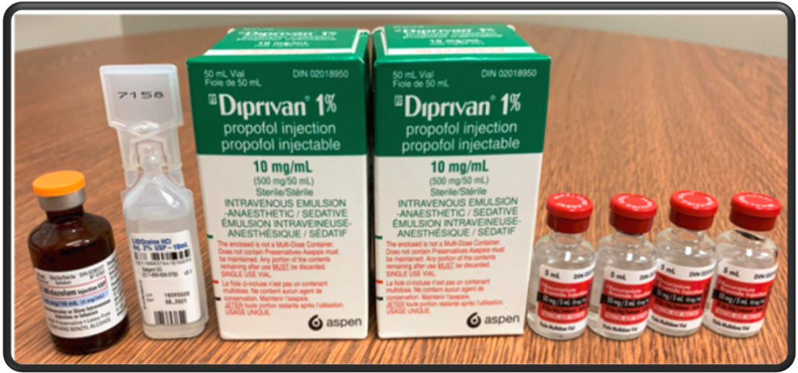
The Medications (in standardized kit from pharmacy)
Midazolam 10 mg
Lidocaine 40 mg
Propofol 1000 mg
Rocuronium 200 mg
Notes:
Midazolam (10 mgs) is used as a well tolerated sleep inducing agent. It also helps to assess proper patency of the intravenous by the observable sedation following administration. If the patient naturally snores, this might occur during the administration.
Intravenous lidocaine (40 mg) is then given regardless of the site of the intravenous to attenuate the discomfort from propofol administration, especially in smaller hand veins.
Propofol (1,000 mg) is a commonly used anesthetic agent, and is administered in MAID to result in cessation of circulation and respiration.
Rocuronium is a powerful paralyzing agent that works on the neuromuscular junction. This prevents any respiration, gasps or agonal breathing and blocks any possible spinal reflexes.
Flushing: Saline flushes are administered at the beginning of the procedure to ensure patency of the line, between lidocaine and propofol, between propofol and rocuronium and after the rocuronium. Flushing between propofol and rocuronium is particularly important to prevent interactions.

Slide 101
The Medical Certificate of Death
Cause of death:
a) Drug toxicity
b) Underlying medical cause precipitating MAiD request such as cancer
Manner of death:
Unclassified (Note-NOT suicide or euthanasia)
Notes:
The Medical Certificate of Death is completed by the provider and left with the body. After a medically assisted death providers are required to state that the primary cause of death is drug toxicity, with the underlying cause of death being the main diagnosis responsible for the request for medically assisted dying. The manner of death is designated as unclassified, using the new Saskatchewan Medical Certificate of Death. Previous versions of this certificate did not have the box to indicate unclassified manner of death, so the provider should make sure that this current form is available. In Saskatchewan the manner of death was initially required to be documented as suicide, which is no longer the case.

Slide 102
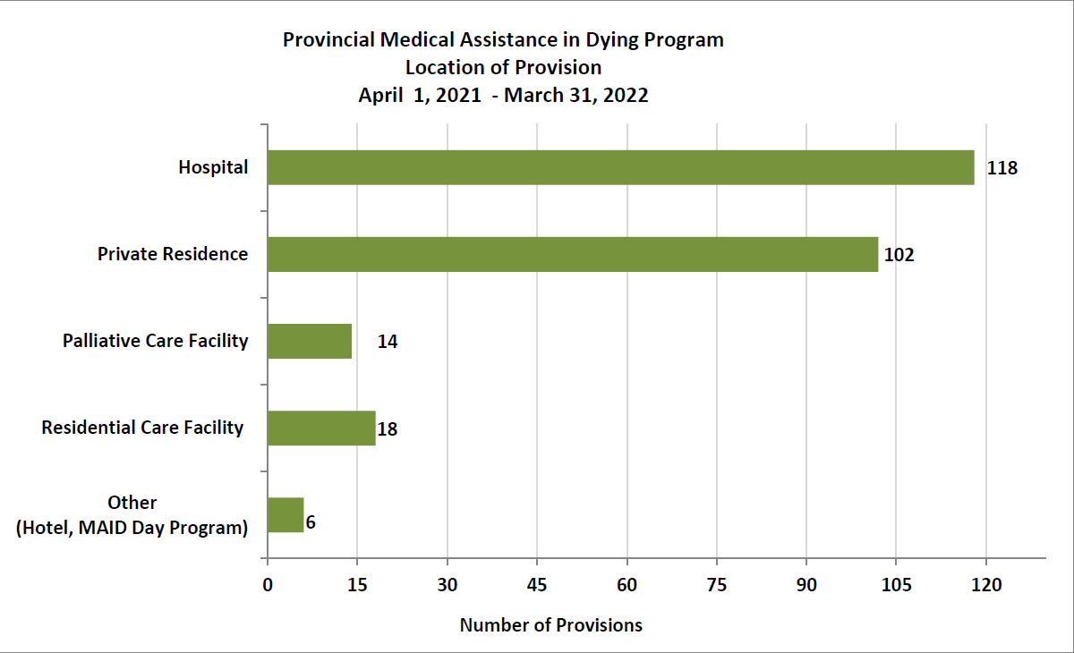
Location of Provision
Notes:
Optional:
Presenter may want to share personal experiences.

Slide 103
Bereavement
Social Work bereavement follow up calls – identified complicated grief prioritized
PMP Nurse provides some bereavement calls
Bereavement mail out package to next of kin
Social work facilitates bereaved to access existing supports (i.e. support groups, community resources, social workers, counsellors, spiritual)
Families can contact PMP for grief support
Notes:
After a death we recognize that there are many individuals who are grieving and impacted by the death as a result of living, loving and having relationships with others.
Bereavement care is a critical component of the continuum end of life care trajectory
The PMP continues to explore ways to offer bereavement supports and that is ongoing
Families can call the program if they need support and we encourage it as we don’t always know who is having a difficult time – PLEASE REACH OUT IF YOU ARE STRUGGLING
We welcome referrals from others involved with the family i.e. healthcare providers, informal supports, spiritual etc. to encourage family to reach out or offer to contact PMP on their behalf

Slide 104
How physicians and nurse practitioners can become assessors and providers

Slide 105
Next steps to Onboarding
SHA approval document
CPSS – Scope of practice
CPSS – sends their approval - Send this to local practioner affairs for privileges. **You must provide us with a copy showing confirmation of these privileges.
Shadowing opportunities
Creation of your forms – housed with the program and sent when arrangements made for assessments
Notes:
Next steps will be that you will be sent forms to complete and sign and send back to the program manager.
From there – she will send to CPSS – CPSS will mail us back the form and we will give to you to take to your local practioner affairs.
IF you would like to work in areas other than your own local area – the program will take this on and help you get your privileges so that we can keep track of who will go where.
WE then will look for opportunities for you to shadow someone assessing a FD or NFD – we do a lot of our work virtually so we would try to give you as much lead time as possible.
We of course work to get you to shadow a provision and look for support for the time that you go alone.
You will bill the ministry/SHA for your work with MAID including your orientation/shadowing – I will forward the codes to you for this and for other work attached to MAID along with travel expense claim forms.
Once you are feeling comfortable – we will let our admin secretary know and she will create your forms that have your name/license prepopulated.

Slide 106
Practitioner Agreement for MAID Practitioners
All practitioners who participate with this additional scope of practice, as either an assessor or provider of Medical Assistance in Dying to patients shall:
1. Adhere to the provincial and federal legislative requirements in the assessment and delivery of Medical Assistance in Dying;
2. Is aware of and will follow the policy/guidelines put forth by their regulatory body (College of Physician and Surgeons of Saskatchewan/College of Registered Nurses of Saskatchewan regarding Medical Assistance in Dying in Saskatchewan;
3. Cooperates with the Provincial Medical Assistance in Dying Program (MAID) in aspects of care coordination in terms of responding to requests for assessors and providers;
4. Provides timely completion and submission of documents back to the Provincial Program.
5. Keeps self-current on legislative processes and seeks out support available within the MAID program. Will engage with the MAID medical director for practice concerns or MAID program manager for operational concerns or questions.
6. Understands that in accordance with Saskatchewan Health Authority (SHA) privacy guidelines, no patient information will be sent to non-SHA addresses;
7. Provincial Provider/Assessor Committee Meetings are offered quarterly to all SHA Provider/Assessors
8. I will update the MAID program of any changes to my contact information or practice.
9. For physicians only - I am aware that I am responsible for obtaining privileges within my own Practitioner Staff Affairs area.
Provincial MAID Program, June 2023

Slide 107
Practitioner Agreement for MAID Practitioners
 I would like to be a MAID assessor (only) I am a Nurse Practitioner
 I would like to be a MAID assessor and provider I am a Physician
Applicant Name (please print legibly):_________________________________________
Applicant Signature: ____________________________________ Date: ______________
(YYYY/MM/DD))
The above named practitioner has agreed to work within the parameters of this agreement.
They are approved for participation in Medical Assistance in Dying with the Saskatchewan Health Authority
Signature: _________________________________________ Date: _____________
Dr. Michele Jagga, Medical Director (YYYY/MM/DD))
Provincial Medical Assistance in Dying Program
Please send completed form to:
Laurie.bradrichards@saskatchewanhealthauthority.ca or fax Toll-Free Fax: 1-833-837-9006
Provincial MAID Program, June 2023

Slide 108
Discussion

Slide 109
Slides for those with special interest

Slide 110
Special Joint Committee on MAID(AMAD) COMMITTEE REPORT-2: ADVANCE REQUESTS
Recommendation 21
That the Government of Canada amend the Criminal Code to allow for advance requests following a diagnosis of a serious and incurable medical condition disease, or disorder leading to incapacity.
Recommendation 22
That the Government of Canada work with provinces and territories, regulatory authorities, provincial and territorial law societies and stakeholders to adopt the necessary safeguards for advance requests.
Recommendation 23
That the Government of Canada work with the provinces and territories and regulatory authorities to develop a framework for interprovincial recognition of advance requests.
https://parl.ca/DocumentViewer/en/44-1/AMAD/report-2/page-165#43

Slide 111
MAID and Organ Donation
Summary of Original and New/Updated Recommendations
Wiebe K et al. Deceased organ and tissue donation after medical assistance in dying:
2023 updated guidance for policy. CMAJ June 26, 2023 195 (25) E870-E878

Slide 112
Deceased organ donation in conscious and competent patients
Deceased organ donation in conscious and competent patients
Before consenting to WLSM or MAiD, patients should carefully consider all end-of-life options with their physician or health care professional.
Wiebe K et al. Deceased organ and tissue donation after medical assistance in dying:
2023 updated guidance for policy. CMAJ June 26, 2023 195 (25) E870-E878

Slide 113
Referral to an organ donation organization
Referral to the organ donation organization should occur as soon as is practical after the decision to proceed with WLSM or determination of eligibility for MAiD. Preliminary evaluation of the patient’s eligibility to donate should be performed before the donation approach, if possible. This avoids the potential distress of making a request or obtaining consent for donation only to have to inform the patient that they are medically or logistically ineligible.
New - All Track Two Patients should be referred to the provincial organ donation organization for information-sharing if a patient initiates a donation discussion, regardless of when this discussion occurs within the 90-day assessment period.
New - All Track Two Patients should be referred to the provincial organ donation organization for information-sharing after a patient initiates a donation discussion, regardless of when this occurs within the 90-day assessment period.
Wiebe K et al. Deceased organ and tissue donation after medical assistance in dying:
2023 updated guidance for policy. CMAJ June 26, 2023 195 (25) E870-E878

Slide 114
Conversations about donation
The decision to proceed with MAiD or WLSM must be separate from, and must precede, the decision to donate.
Treating physicians, MAiD providers and MAiD assessors should be educated on how to respond to inquiries concerning organ donation. This should include how the decision to donate may affect the end-of-life care process and options, and when to refer patients to the organ donation organization. The organ donation organizations should develop checklists or discussion guides to facilitate donation conversations to ensure patients are consistently well informed.
All eligible, medically suitable patients should be given an opportunity to consider organ and tissue donation, consistent with provincial or territorial required referral legislation, regional policy and ethical principles of respect for autonomy and self-determination. However, this must be reconciled with regional values and health care culture. Initially, some jurisdictions might prefer to begin with systems that respond only to patient-initiated requests.
Donation coordinators will have to tailor their conversations to ensure the patient remains the centre of the MAiD or WLSM and organ donation process, to ensure patient autonomy.
When an approach is to be made, discussions should happen early to allow individuals time to consider the options, ask questions and plan accordingly.
Patients and their families should be provided with standardized information resources, such as online material or pamphlets, to help guide responses to donation inquiries. The decision to proceed with MAiD or WLSM must precede discussions about donation.
Wiebe K et al. Deceased organ and tissue donation after medical assistance in dying:
2023 updated guidance for policy. CMAJ June 26, 2023 195 (25) E870-E878

Slide 115
Consent
The patient must have the ability to provide first-person consent to MAiD or WLSM as well as to organ and tissue donation.
Physicians, MAiD assessors, and WLSM or MAiD providers should be cognizant of the risk of coercion or undue influence on patients to donate their organs; however, the patient’s altruistic intentions should not be discouraged.
Donation discussions must respect patient autonomy, and first-person consent should be obtained and upheld. Although it is welcomed and encouraged that family members are included in donation conversations, consent must be obtained from the patient and conversations should be focused on them.
The individual should be informed and understand that they may withdraw consent for MAiD or donation at any time, and that withdrawal of consent for donation does not affect their consent for, or access to, MAiD or WLSM.
The donation team should make every effort to resolve conflict, through dialogue, between the patient’s expressed wishes to donate and a family’s disagreement. First-person consent should direct all subsequent decisions unless consent was revoked.
Wiebe K et al. Deceased organ and tissue donation after medical assistance in dying:
2023 updated guidance for policy. CMAJ June 26, 2023 195 (25) E870-E878

Slide 116
Consent cont.
New – All Track Two Patients who are potentially eligible for organ donation should be approached for first-person consent to donation following MAiD after MAiD eligibility has been confirmed, regardless of when their eligibility for MAiD is confirmed within the 90-day assessment period.
The donation team must understand and abide by the laws and policies of their jurisdiction with respect to reporting of MAiD deaths (e.g., coroner, special committee).
To facilitate donation, these parties should be contacted before the MAiD procedure, in accordance with the current laws and policies.
Wiebe K et al. Deceased organ and tissue donation after medical assistance in dying:
2023 updated guidance for policy. CMAJ June 26, 2023 195 (25) E870-E878

Slide 117
Donor testing and evaluation
Primary care physicians, staff of organ donation organizations, MAiD providers and transplant teams should work to minimize the impact and inconvenience to the patient of donating their organs. This could include scheduling home visits for blood draws and coordinating investigations (e.g., x-rays, ultrasound) to minimize hospital visits and inconvenience to the individual.
Transplant teams and surgeons should work with the donation team to determine the minimum necessary investigations, to avoid the burden of excessive assessments and testing.
Donor teams should routinely discuss the potential impact of unanticipated results from the donor investigations, including previously undiagnosed infectious diseases, and their impact on public health reporting and contact tracing.
Wiebe K et al. Deceased organ and tissue donation after medical assistance in dying:
2023 updated guidance for policy. CMAJ June 26, 2023 195 (25) E870-E878

Slide 118
MAiD procedures
New -For Track One Patients receiving MAiD after loss of capacity who require admission to the hospital for donation, transfer and admission to the hospital should be coordinated with the SDM.
New -Track Two Patients must provide first-person consent immediately before the MAiD procedure. As such, first-person consent should be obtained before transfer and admission to hospital for donation.
New -Further work is needed to assess the potential for donation following MAiD at home in Canada.
In the interim, patient-initiated requests for donation following MAiD at home warrant consideration on a case-by-case basis, where feasible.
Wiebe K et al. Deceased organ and tissue donation after medical assistance in dying:
2023 updated guidance for policy. CMAJ June 26, 2023 195 (25) E870-E878

Slide 119
Determination of death
The dead donor rule must always be respected.
This principle stipulates that donors must be dead prior to organ/tissue procurement, that organ/tissue procurement cannot be the cause of death, i.e., patients must not be killed by the act of organ or tissue retrieval. (CMA. Organ and tissue donation and transplantation update 2015).
Vital organs can be procured only from a donor who is already deceased; the act of procurement cannot be the immediate cause of death.
Wiebe K et al. Deceased organ and tissue donation after medical assistance in dying:
2023 updated guidance for policy. CMAJ June 26, 2023 195 (25) E870-E878

Slide 120
Separation of decisions
To avoid any real or perceived conflict of interest, health care practitioners should separate the decision regarding WLSM or MAiD from discussions concerning donation. Providers who are assessing eligibility for MAiD should not be involved in donation discussions. Discussions concerning donation should happen only after WLSM decisions are made, or patients have been found eligible for MAiD by 2 independent assessments.
The primary health care team should acknowledge patient inquiries concerning donation that are made before a decision to proceed with MAiD or WLSM. General information on deceased organ and tissue donation may be provided. However, specific discussion and decisions pertaining to donation should wait until the decision to proceed with MAiD or WLSM has been finalized.
Patients may wish to postpone their MAiD procedure, owing to a temporary improvement in their health or an event they wish to experience before their death. The freedom of the patient to postpone their MAiD procedure must be reinforced and preserved, and every effort should be made to honour their wishes to donate their organs should their MAiD procedure be rescheduled.
Wiebe K et al. Deceased organ and tissue donation after medical assistance in dying:
2023 updated guidance for policy. CMAJ June 26, 2023 195 (25) E870-E878

Slide 121
Directed and conditional donation
Living donation before death from patients considering MAiD or WLSM should be neither offered nor encouraged. Should a patient insist on living donation before death, the request should be considered on a case-by-case basis.
New - Organ donation organizations and transplantation programs should develop a directed deceased donation policy for patients pursuing MAiD, in alignment with the directed donation principles and practices that are in place for living donation in their jurisdiction.
Wiebe K et al. Deceased organ and tissue donation after medical assistance in dying:
2023 updated guidance for policy. CMAJ June 26, 2023 195 (25) E870-E878

Slide 122
Separation of roles
Consistent with current guidelines and practice regarding donation after death determination by circulatory criteria, separation should be maintained between the end-of-life care, donation and transplant teams. Surgical recovery and transplant teams should not be involved in the patient’s end of-life care or MAiD or WLSM procedure. The only exception is insofar as they may provide guidance for minimal requirements for donor investigations or premortem interventions.
Patients who wish to donate their organs after MAiD or WLSM, but who request that their decision to pursue MAiD or WLSM remain confidential, should be informed of the risk that their family members may discover incisions associated with surgical retrieval of organs. They should be encouraged to disclose their decision to family members; however, there is no obligation to stop the donation process should the patient wish to maintain the confidentiality of their MAiD or WLSM procedure.
That an organ donor received MAiD should not be disclosed to the potential recipient during allocation; however, medically relevant information regarding their underlying disease may be disclosed according to guidelines for exceptional distribution, where applicable.
Wiebe K et al. Deceased organ and tissue donation after medical assistance in dying:
2023 updated guidance for policy. CMAJ June 26, 2023 195 (25) E870-E878

Slide 123
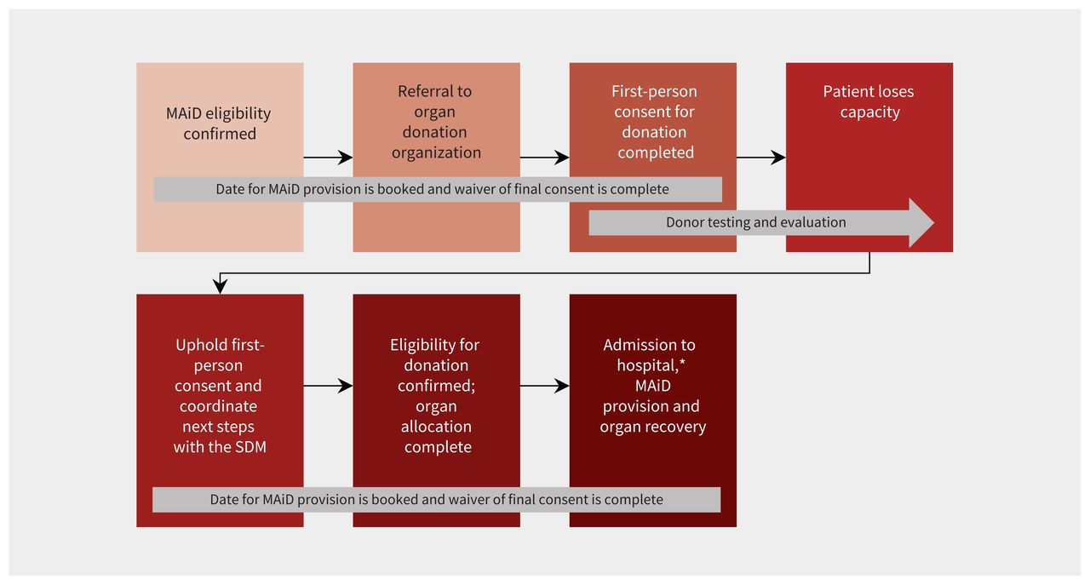
Flow chart for loss of capacity after first-person consent for MAiD but before first-person consent for donation in Track 1 patients.
Wiebe K et al. Deceased organ and tissue donation after medical assistance in dying:
2023 updated guidance for policy. CMAJ June 26, 2023 195 (25) E870-E878

Slide 124
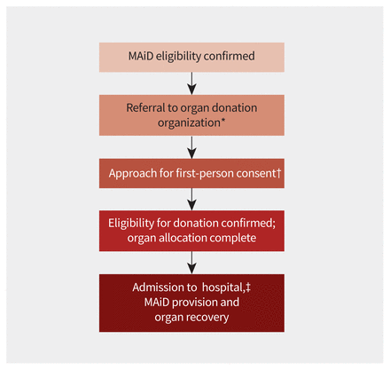
Flow chart for referral and consent for donation after medical assistance in dying (MAiD) in Track 2 patients
Wiebe K et al. Deceased organ and tissue donation after medical assistance in dying:
2023 updated guidance for policy. CMAJ June 26, 2023 195 (25) E870-E878

